Slide 1


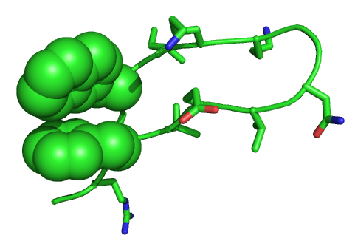

Development of Peptide Based Biocatalysts for the Desulfurization of Dibenzothiophene
Chad D. Tatko, Department of Chemistry and Biochemistry, Calvin College
Sulfur substrate
The combustion of sulfur generates sulfur oxyacids that contribute to deforestation and cardiopulmonary disease. The current technology for reducing sulfur content in fuels, hydrodesulfurization, cannot eliminate recalcitrant aromatic sulfur compounds. Discovery of bacteria that metabolize aromatic sulfur heterocycles has led to significant interest in biocatalytic desulfurization. Peptide based biocatalysts do not need the aqueous environment of a host organism, but may retain essential function. We have designed diagonal and lateral aromatic clefts that suggest binding can be achieved.
Sulfur substrate

