Slide 1
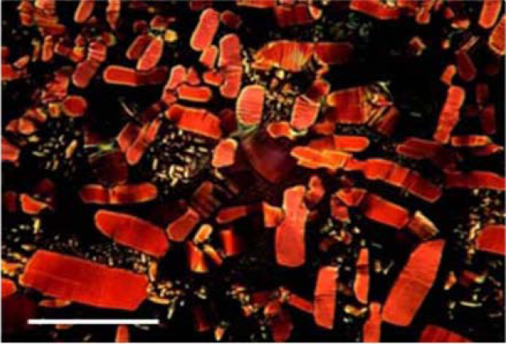
A New Type of Discotic Liquid Crystals for Organic Solar Cells
Liang-shi Li, Department of Chemistry, Indiana University, Bloomington IN 47405
Liquid crystalline organic semiconductors: Solution-processable organic semiconductors are important components in low-cost organic electronics including organic photovoltaics, light emitting diodes, and field effect transistors. However, the low electrical conductivity of the common solution-processable organic semiconductors has been a factor limiting the device performance.
Our goal is to develop a new type of discotic liquid crystalline semiconductors for organic solar cells. Processed with solution-based methods, the liquid crystals can have long-range supramolecular order and thus can transport charges with large speed. In addition, the compounds we target will have the ability to simultaneously optimize photoinduced charge separation and the subsequent charge transport to electrodes, and therefore are ideal for fabricating organic solar cells.
So far we have developed a general route to hexa-peri-hexabenzocoronene with C₃-symmetry (HBC, shown below, R₁≠ R₂), a key intermediate to our final targets. HBC themselves are an interesting type of organic semiconductors, and we show that they can have highly-ordered liquid crystalline phase at room temperature (image below: birefringent pattern observed from a HBC thin film between two crossed polarizers. Scale bar: 50 μm).
The room-temperature liquid crystals not only enable high charge transport efficiency, but also enable the solar cells to be self-healing due to the low viscosity of the liquid crystals.

