Slide 1
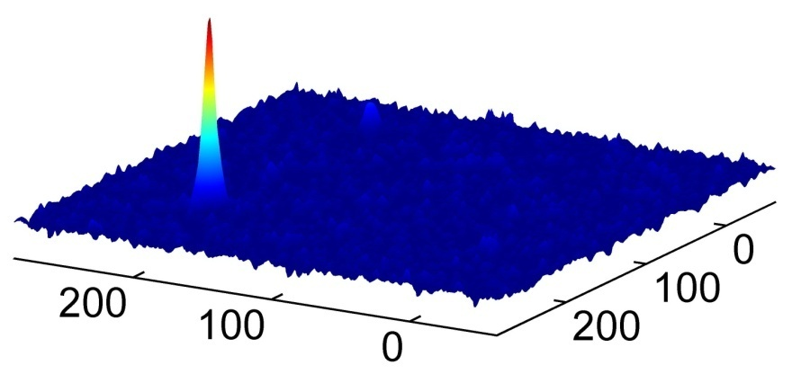
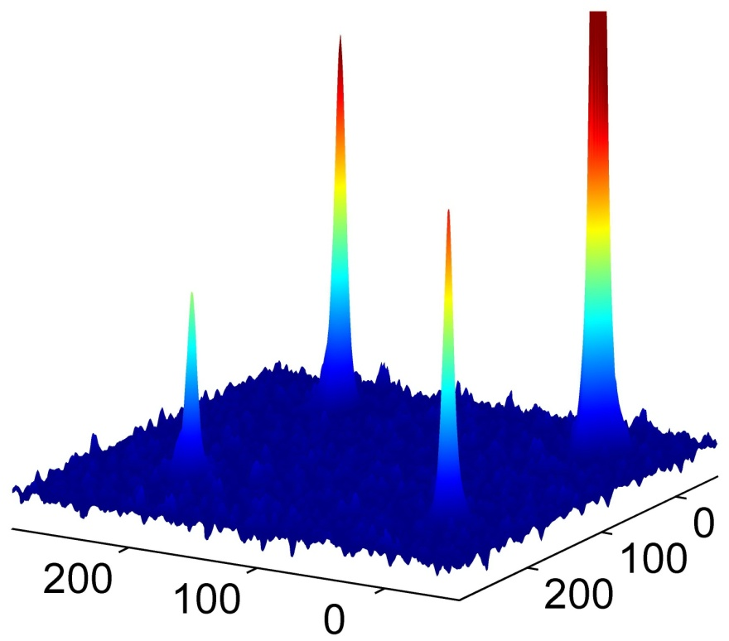
Figure 5. Hyperpolarized ¹²⁹Xe 2D exchange spectra in Ga₁₀ nanotubes at 25ºC, acquired in (a) continuous flow mode, using a mixing time of 250ms, and (b) interrupted flow mode, using a mixing time of 1s. The gas peak is truncated to facilitate comparison of the cross-peaks. Labeling of peaks is as follows: c→c (channel-to-channel) and g→g (gas-to-gas) diagonal peaks; c→g (channel-to-gas) and g→c (gas-to-channel) cross-peaks.

