Slide 1
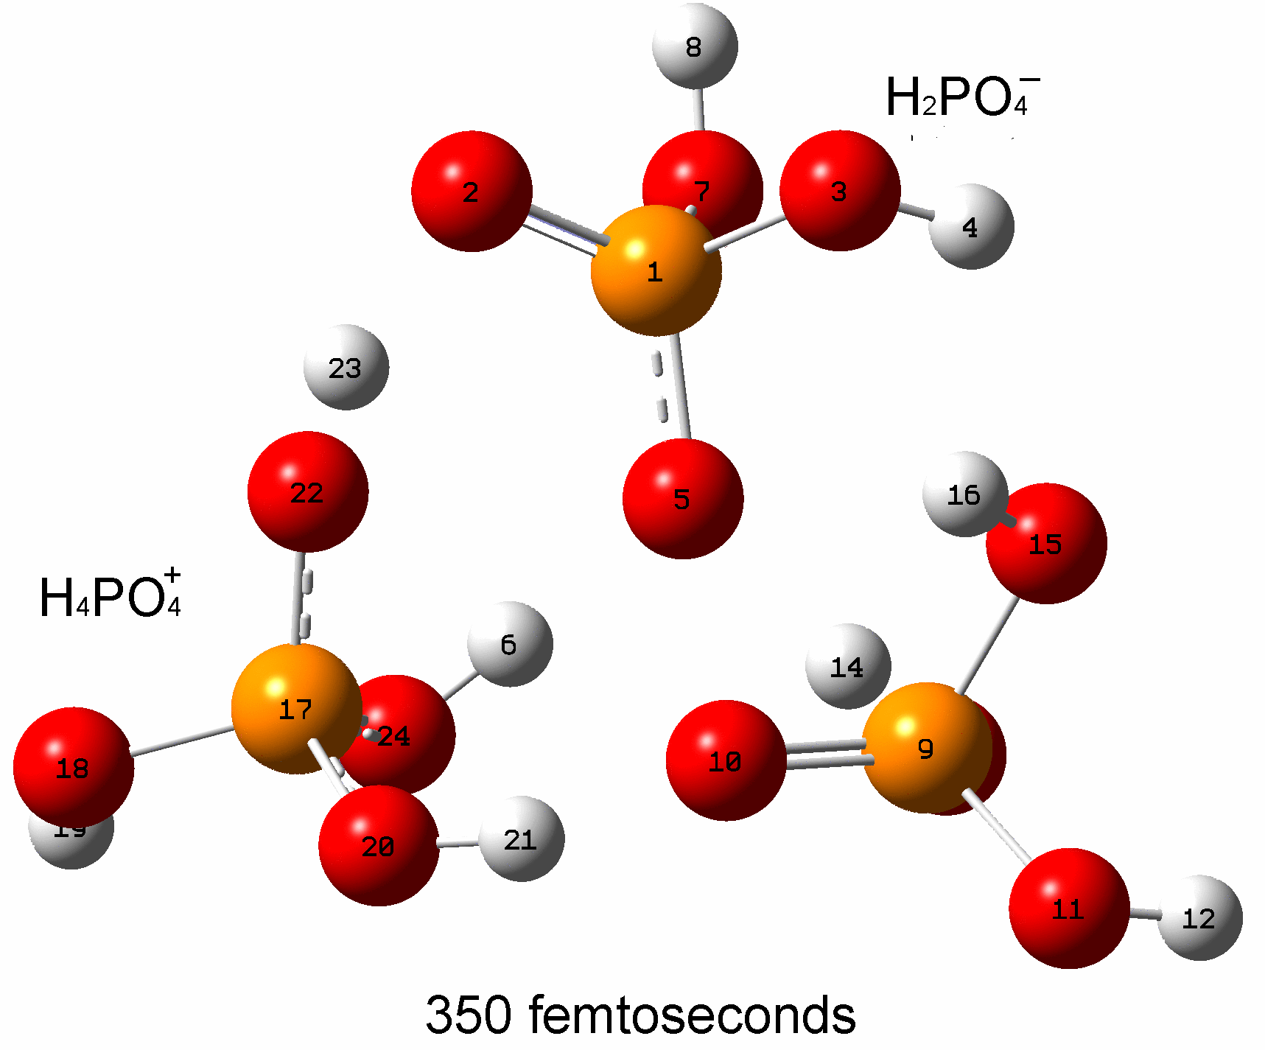
Proton Transfer in Phosphoric Acid Based
Fuel Cell Membranes
Joel R. Fried, Chemical & Materials Engineering
Phosphoric acid (PA), H₃PO₄, is used as a dopant in fuel cell membranes including those made from high-temperature polymers such as polybenzimidazoles in order to increase conductivity. The focus of this project is to study the mechanism of proton transfer (PT) in silico for several different PA-doped polybenzimidazole systems using hybrid ab initio (ADMP) molecular dynamics techniques. Proton affinities of PA and intermediate structures have been obtained using MP2 calculations with quad zeta basis sets as well as by DFT (B3LYP) calculations. For the first time, ADMP B3LYP/6-31++(d,p) calculations of a cluster of three PA molecules at 298 K has shown that PT in PA can occur in less than 55 fs as shown by the time series below; within 350 fs, two PA ionic species (i.e., H₄PO₄⁺ and H₂PO₄⁻) have formed through three PT events.
two proton transfers
one proton transfer

