Slide 1
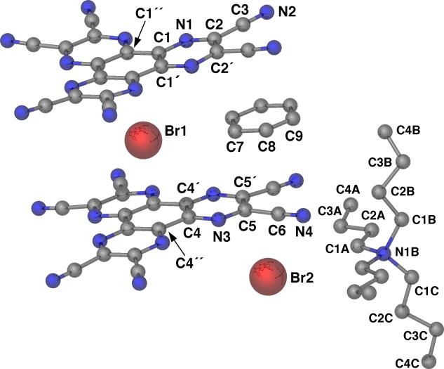
Systematic and Theoretical Studies of Anion-pi Interactions for the Development of Supermolecules and New Materials
Current research focuses on the synthesis of anion-templated square and pentagonal transition metal architectures involving anion-pi interactions. The synthesis of diamagnetic Fe(II) pentagon (ball and stick, left and space filling, center below) and square motifs has allowed us to begin NMR studies of their formation in solution. The Fe-N distances in the X-ray analysis (1.84-2.04 Å), as well as preliminary NMR studies, support the assignment of low-spin Fe(II).
3.07 Å
3.11 Å
2.82 Å
2.77 Å
Another avenue of research is the analysis of anion-pi and charge-transfer interactions in previously synthesized HAT(CN)₆/Br⁻, Cl⁻ (bromide above, right) supramolecular complexes via solution and computational studies. The determined association constant values from the Job plot analysis of the UV/vis spectra (right) increase in the order K_{CT,Cl} > K_{CT,Br} > K_{CT,I}. Natural bond orbital analysis of computations (involving both the outer and central anion positions, as well as [Cl]⁻ and [Br]⁻) reveal that there is a greater degree of CT present between the HAT(CN)₆ molecule and the [Cl]⁻ anion than with the [Br]⁻ anion, and that the center position involves less CT than the outer position.

