Slide 1
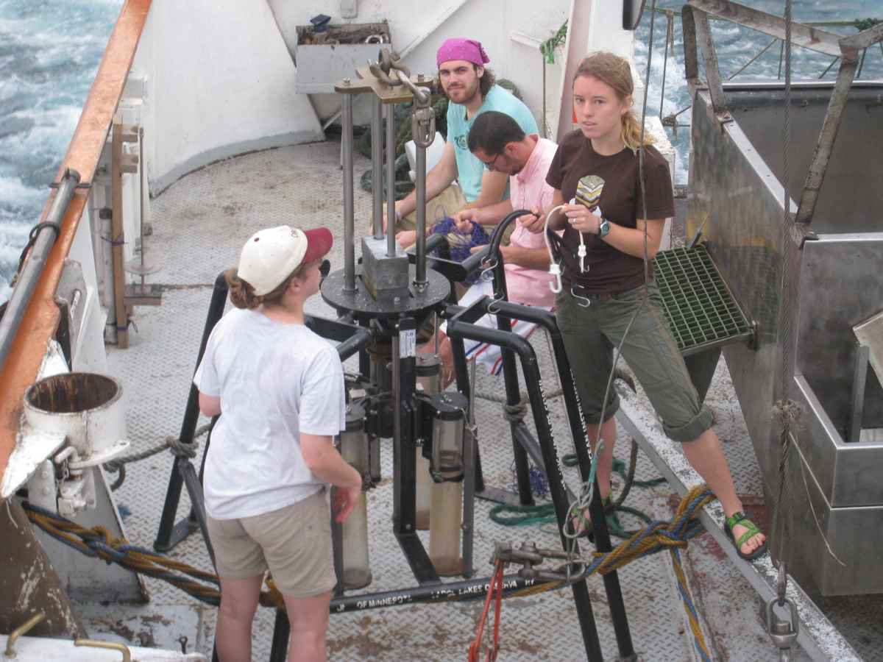
Characterizing organic matter in sediments of a tropical rift lake
ACS – PRF Grant 48595-AC2
Thomas C. Johnson, PI
University of Minnesota Duluth
Large Lakes Observatory

