Slide 1
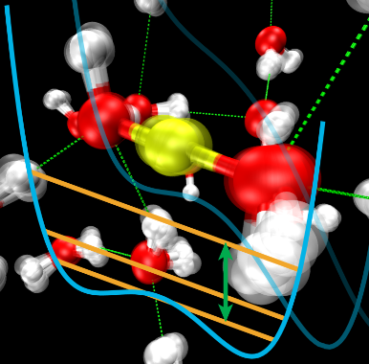
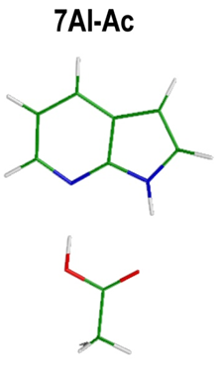
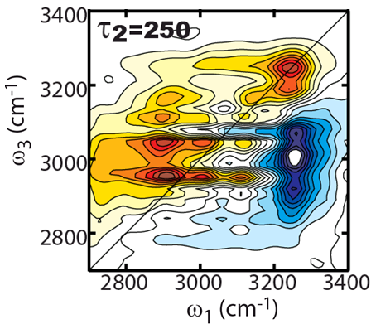
2D IR Spectroscopy of Proton Transfer Dynamics
Andrei Tokmakoff, MIT Department of Chemistry, Cambridge, MA 02139
Proton-transfer dynamics in aqueous hydroxide solution.
Protons transfer from water to hydroxide, displacing the ion. The Zundel-like H₃O₂⁻ species is a transition state which lives for 120 fs.
Proton-transfer dynamics in asymmetric HB dimers
Intermolecular fluctuations modulate the hydrogen-bonded proton potential, allowing effective proton transfer across the strong HB.

