Slide 1
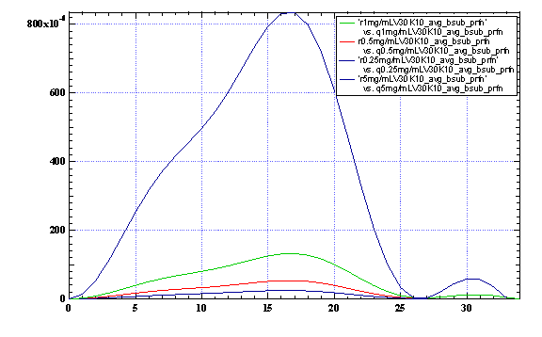
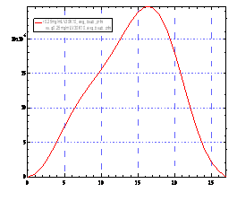
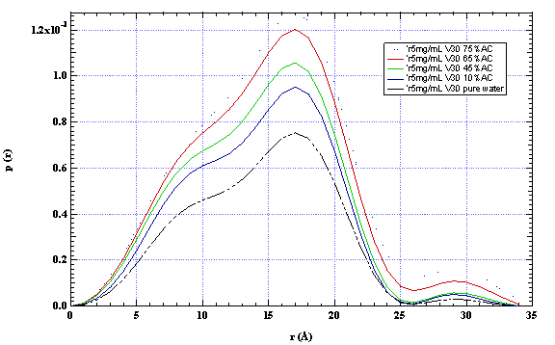
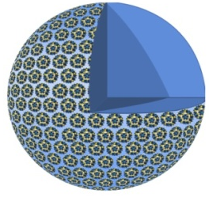
Study the State of Counter-ions in Polyoxometalate Solutions (PRF G-46294)
Tianbo Liu, Lehigh University
Na₈K₁₄(VO)₂[{(Mo)Mo₅O₂₁(H₂O)₃}₁₀{(Mo)Mo₅O₂₁(H₂O)₃(SO₄)}₂{VO(H₂O)}₂₀{VO}₁₀({KSO₄}₅)₂]·150H₂O
single {Mo₇₂V₃₀} cluster – 2.5-nm hollow sphere
concentration
add acetone
0.05 mg/mL {Mo₇₂V₃₀}:
cations are all free.
0.2 – 0.9 nm
Free cations
0.2 – 0.9 nm
Blackberry formation
Discrete POMs
Pigga, J. M.; Kistler, M. L.; Shew, C.-Y.; Antonio, M.; Liu, T.
Angew. Chem. Int. Ed. 2009, 48, 6538.

