Slide 1
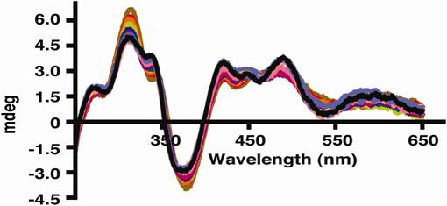
Modulation of Reduction Potentials of [2Fe-2S] Iron Sulfur clusters
Laura Hunsicker-Wang, Department of Chemistry, Trinity University,
San Antonio, TX 78212
How iron sulfur proteins modulate reduction potential is a fundamental question in biological chemistry. The factors that govern reduction potentials are thought to include the number and type of hydrogen bonds to the cluster, the number of charged residues near the cluster, and hydrophobicity of the environment around the cluster. In our work, each of the implicated factors are being tested by making site-directed mutations
and determining the resultant reduction potential in the Rieske protein from Thermus thermophilus . Conformational or electronic changes that might accompany the changes in reduction potential are ascertained through X-ray crystallographic and spectroscopic studies. Several mutations: Y158F, G156S , L135A, and L135E have been produced, which test the effect of removing an OH-S hydrogen bond, adding a hydrogen bond, changing the solvent accessibility of the histidine ligands to the cluster and adding a negative charge adjacent to the cluster. All of the proteins show a pH-dependence of the UV-Visible and the circular dichroism spectrum. pK_{a}’s of the oxidized protein can be determined using both techniques. Reduction potential measurements have provided the low pH potential for tWT, FLWT, Y158F and L135A. All show the expected trends. X-ray crystallographic data for tWT have been published, and structure refinement for L135A and Y158F are underway.
pH-dependent CD spectra tWT
Low pH-reduction potential and pK_{a} values of different forms and mutants of the Rieske protein
Protein | Low pH reduction potential (PFV)ª | pK_{ox1} , pK_{ox2}^{b} | Resolution of crystallographic data
TtRp | 159 mV | 7.48, 10.07
truncTtRp | 157 mV | 7.87, 9.84 | 2.1 Å^{c}
Y158F | 93 mV | 8.17, 10.13 | 1.85 Å
L135A | 147 mV | 8.40, 10.45 | 2.2 Å
ª determined in the Elliot lab, ^{b} determined through pH-dependent UV-Visible titrations ^{c} reported in Konkle et al. Biochemistry 2009

