Slide 1
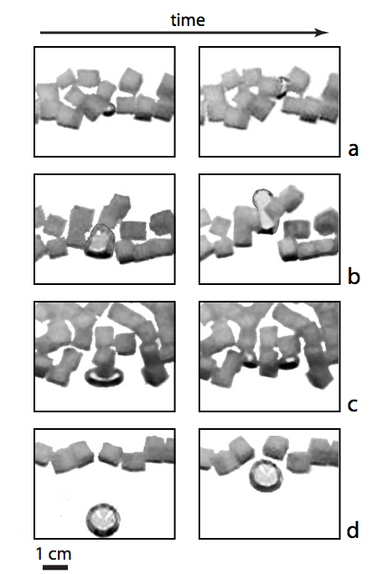
Hydrate Distribution, Dissociation, and Growth in Sediments
2. Analogue experiments demonstrate the splitting and coalescence of gas bubbles that can control gas flux through marine sediments.
1. Comparisons of hydrate growth forms (left) with ice segregation in porous media (right) motivate a new model for the development of hydrate nodules.
The chemical potential is lowered by the effects of curvature and interfacial interactions across thin liquid films that cause the particle displacements that enable nodule growth.
Alan Rempel, Department of Geological Sciences, University of Oregon, Eugene 97403-1272.

