Slide 1
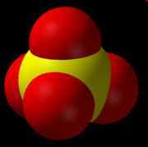
SO₄²⁻
~75% H₂O
~25% O₂
Oxygen source partition for sulfate formed by abiotic pyrite oxidation

