Slide 1
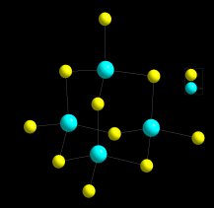
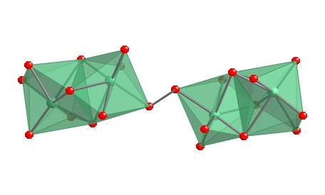
Synthesis of Novel Chalcogenide Materials Using a Building Block Approach and Molten Flux Methods
Benny C Chan, Chemistry Department, The College of New Jersey, Ewing, NJ 08628
We have also began some new studies of the reactivity of alkali chalcogenide fluxes with niobium metal. Two new phases were discovered, Cs₆Nb₄Se₂₂ and K₁₂Nb₆Se₃₅ through a reaction of A₂Se₂ , Se, and Nb metal at 500 C.
Chalcogenides have numerous applications including optoelectronics, catalysis, magnetism, and thermoelectrics. Our research studies synthetic strategies to prepare novel chalcogenides. Much of solid state chemistry is dominated by serendipity in the formation of new compounds.
 | Cs₆Nb₄Se₂₂ | K₁₂Nb₆Se₃₅
a, ang | 12.5837(6) | 8.3669(4)
b, ang | 8.5095(4) | 13.3510(6)
c, ang | 20.3064(9) | 56.231(3)
α, β, γ | 90, 103.855(1), 90 | 90, 90, 90
Space group | P 2₁/c | Pbcn
R factor | 0.0475 | 0.0595
K₂P₂Se₆
K₄Ge₄S_{10(s)}
Our main thrust is to study solvothermal methods and the use of preformed building blocks to form novel compounds. We have studied the reactivity of K₂P₂Se₆ and K₄Ge₄S₁₀ building blocks towards LaCl₃ under a variety of solvents including methanol, ethylene diamine, acetonitrile, and water between 100-200 C in a 23 mL Parr bomb.
2K₂S_{(s)} + 4Ge_{(s)} + 8S_{(s)}
+ LaCl_{3(s)}
→
Cs₆Nb₄Se₂₂
yellow blocks, Ge
We have compared the building block approach with simply using binary and elemental reactants.
We have discovered some unidentified and novel phases through PXRD, Single Crystal studies are underway.
K₁₂Nb₆Se₃₅
We hope to expand these studies to potential thermoelectric materials in the bismuth chalcogenide and rare earth composition space.

