Slide 1
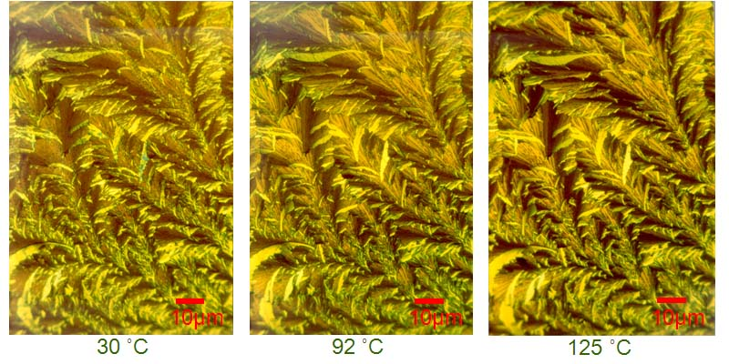
Design and Synthesis of Novel Pyrene Discotics and Their Investigation in Organic Photovoltaic Cells
Bilal R. Kaafarani, Department of Chemistry, American University of Beirut, Beirut, Lebanon
T(ºC)
-5ºC/min
K₂ Phase
K₃ Phase
K₄ Phase
Iso.
K₄
K₃
K₂
K₁
Endo.
➢ DSC and 1D WAXD results of TQPP-[SC₁₂H₂₅]₄ showed that this compound possesses four crystalline, but no liquid crystalline, phases.
➢ The photophysical properties with an in-depth spectroscopic characterization of TQPP-[t-Bu]₂-[XC_{n}H_{2n+1}]₄ (X = O, S) compounds were investigated.
J. Phys. Chem. B 2009, 113, 5403; J. Phys. Chem. A 2009, 113, 1235; J. Phys. Chem. A 2009, 113, 1244.

