Slide 1
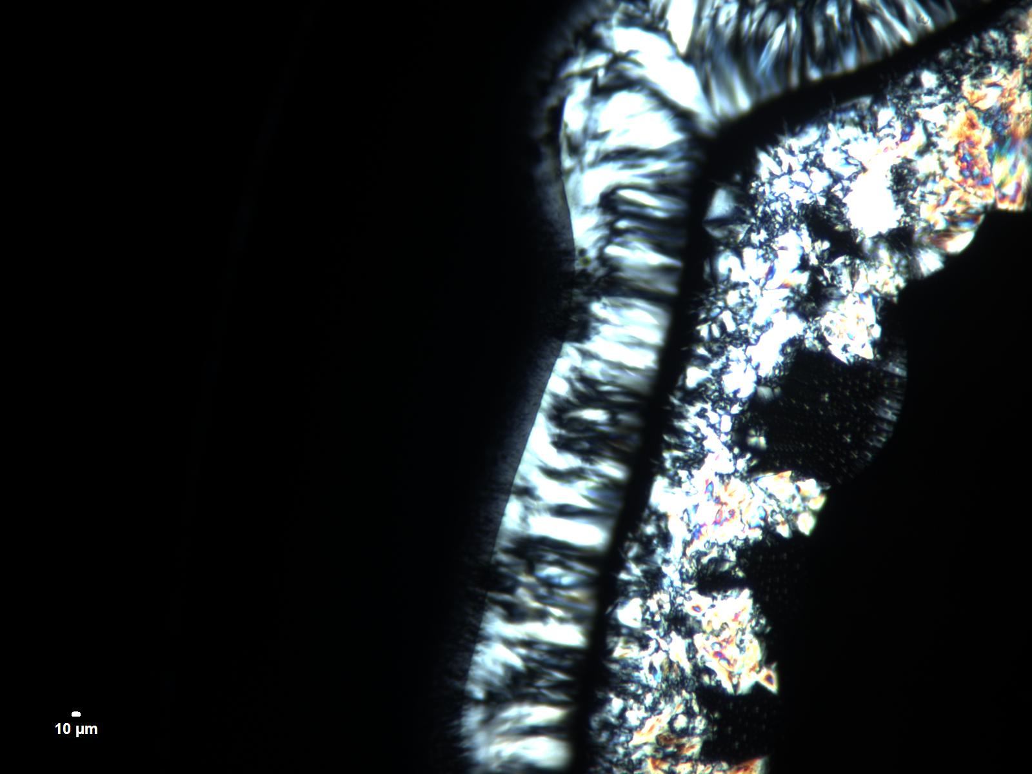
Bicontinuous conducting polymer cubic phases using non-ionic surfactants
water
NP-9
L
Lamellar
M
Micellar
H
Hexagonal
Polarized light
G
Cubic
Diffusion couple formed between water (upper left) and
non-ionic surfactant showing characteristic optical textures

