Slide 1
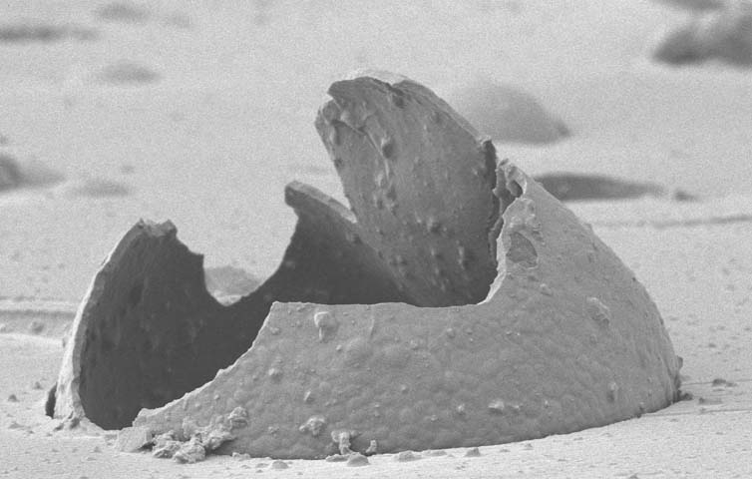
ROMP Healing Agent Development for Self-Healing Materials
Michael Kessler
Department of Materials Science and Engineering
Iowa State University
2220 Hoover Hall
Ames, IA 50011, USA
Self-healing polymers incorporate liquid healing agent-filled microcapsules and catalyst particles into a polymer matrix. Upon material fracture, microcapsules rupture, followed by flow of the liquid healing agent into the crack volume. When the healing agent contacts the catalyst particles it polymerizes and adheres the crack faces together (left). Seminal works in the field of self-healing has only utilized a few healing agent/catalyst combinations with minimal optimization. We have expanded on this initial work by developing new healing agents and catalysts that exhibit superior self-healing capabilities. All of our healing agents are ring-opening metathesis polymerization (ROMP)-based liquids whose polymerizations are initiated by ruthenium-based olefin metathesis catalysts (below).

