Slide 1
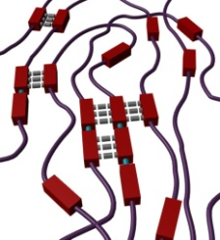
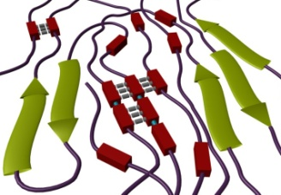
Hierarchically-assembled Segmented Polyurethanes: Mechanical Reinforcement in a Multi-phase Elastomeric System
Goals
Synthesize nature-inspired, novel polypeptide/polyurethane hybrid systems.
Explore the effects of hierarchical ordering through the incorporation of polypeptides on the thermal and mechanical properties of segmented polyurethanes.
Utilize this understanding to develop tough materials for scratch and/or impact resistant coatings and films
Accomplishments
Designed and synthesized novel hybrid polypeptide/polyurethanes containing:
Initial thermomechanical studies confirm additional ordering enhances the storage modulus (shown in figure below)
Poly(γ-benzyl-L-glutamate)-b-Poly(dimethylsiloxane)-b-poly(γ-benzyl-L-glutamate)
Segmented Polyurethanes (PUs)
Segmented PUs are multi-block polymers usually consisting of an amorphous, flexible soft segment and a rigid crystalline or high glass transition (T_{g}) hard segment. The flexible segments form a continuous domain, which is anchored by physical crosslinking of the hard segment aggregates.
Hard domain
Soft domain
Peptide segment
Temperature-dependent storage modulus of SPUs with and without polypeptide segments. Notice PU with polypeptide retains higher modulus through wider temperature range.
Typical PU
Proposed PU

