Slide 1
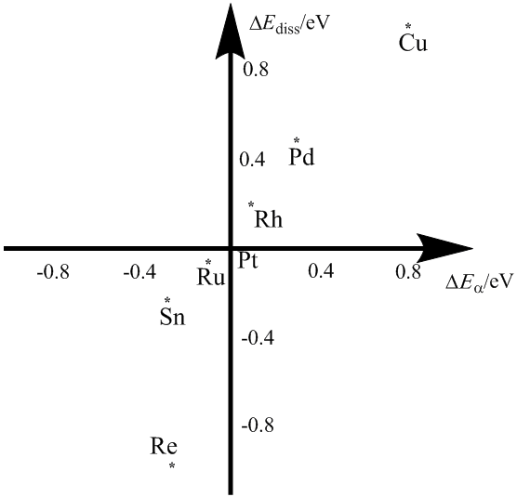
On the activation mechanism of Sn to the EER of ethanol: decomposition of H₂O and ethanol over PtnM clusters Yixuan Wang, Albany State University, Albany, GA 31705
The fundamental assumption of the bi-functional mechanism for PtSn alloy to catalyze ethanol electro-oxidation reaction is that Sn facilitates the dissociation of H₂O and Pt site catalyzes ethanol decomposition. Our investigation is to clarify this assumption and get detailed information about decomposition mechanism of H₂O and CH₃CH₂OH.
A two layer cluster with 7 atoms on the surface and 3 atoms on the second layer, has been used to model Pt-M alloy surface. Relative to the adsorbed water, it is interesting to find that thermodynamically and kinetically the decomposition of the adsorbed water on Sn site is more favorable than the decomposition on Pt and Ru sites. Taking Pt as a reference, the plot of relative Ea against relative E_{diss} for water dissociation over the investigated transition metals M (Pd, Ru, Rh, Cu, Sn, and Re) is illustrated. According to the plot, the bimetallic alloys PtM (M=Re, Sn and Ru) are more active to water dissociation both kinetically and thermodynamically, while the bimetals alloying with Cu, Pd and Rh are less active than Pt from both aspects. This result supports the assumption of the bi-functional mechanism, where Sn site facilitates the dissociation of H₂O.
The relative dissociation energy against the relative energy barrier for water dissociation over the M site of Pt₉M.
External electric fields were added into DFT calculations of H₂O-Pt_{n}M (n=6 and 9; M=Pt, Sn and Ru). Although activation energies over Pt₆M have the opposite change to those over Pt₉M, PtSn still exhibits the most active kinetically to water decomposition among the three clusters.

