Slide 1
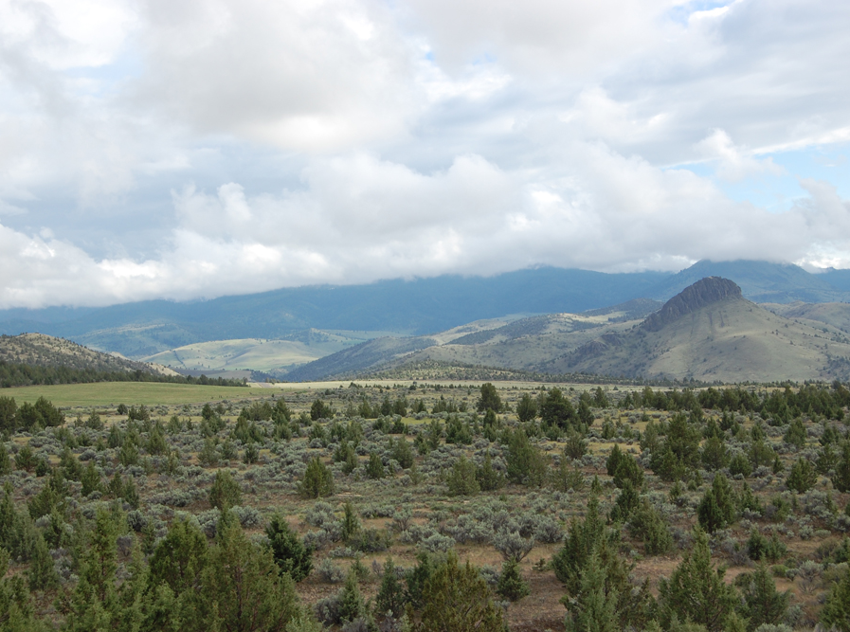
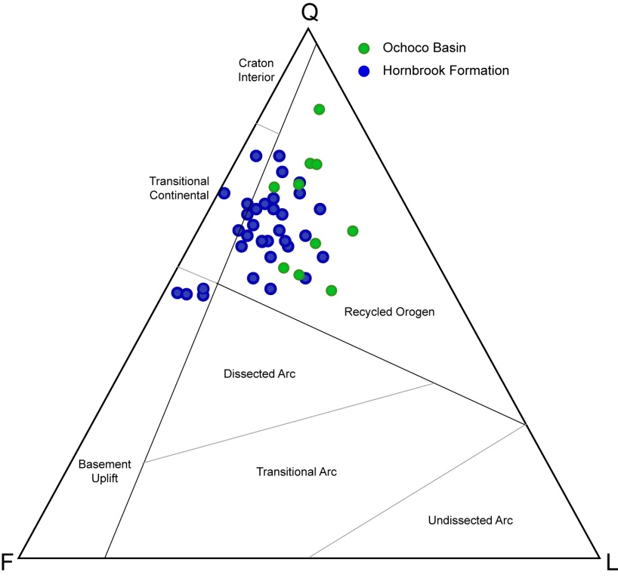
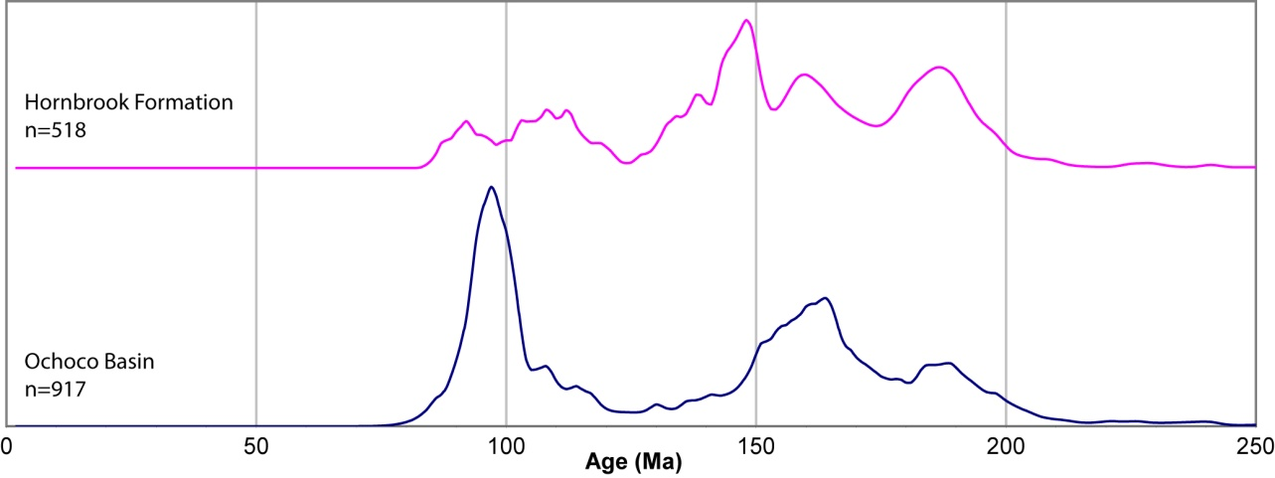
Detailed provenance analysis of the Ochoco Basin, Oregon: A possible continuation of the Hornbrook Formation
Kathleen D. Surpless, Department of Geosciences, Trinity University, San Antonio TX 78212
Significant results:
Appearance of 98 Ma age peak in Ochoco Basin requires non-Blue Mountains sediment source; likely a northern Sierran arc source.
Two geochemically-distinct sources contributed sediment to the Ochoco Basin, one provided more volcanic detritus than the other.
Overlap in detrital zircon ages, sandstone petrography, and geochemical signatures suggests a possible link between the Hornbrook Formation and the Ochoco Basin during deposition.
Continuing work:
Verify and document apparent overlap in geochronology and geochemistry to test spatial versus temporal relationship throughout the Hornbrook and Ochoco basins.
Neodymium analysis of fine-grained sediment in each basin to test if basins were contiguous during deposition.

