Slide 1
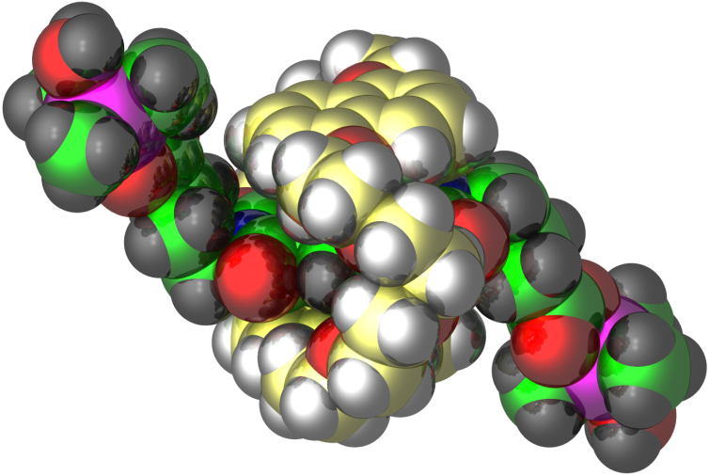
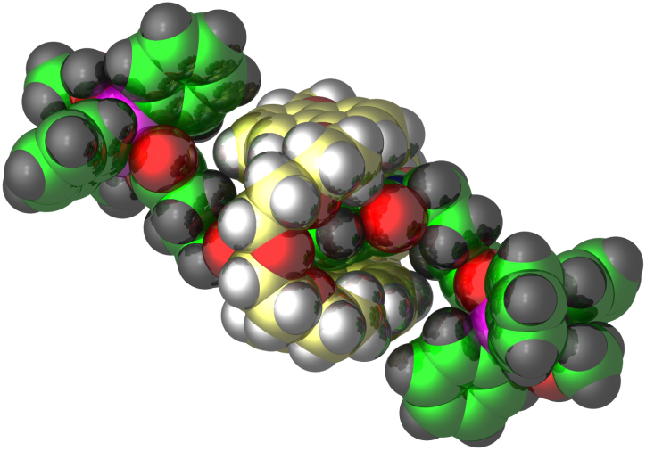
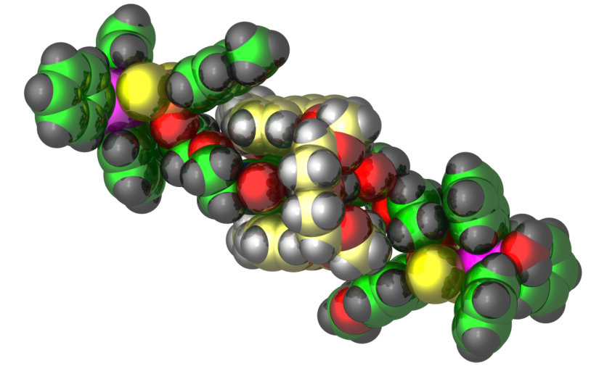
Novel Organic-Inorganic Hybrid Cage Architectures
Radu F. Semeniuc, Department of Chemistry, Eastern Illinois University
The synthesis of Metal-Organic-Rotaxane-Frameworks witnessed an increased interest
during the last decade, due to their potential to function as molecular machines.
We have successfully synthesized anionic rotaxanes that produced, after coordination
to cationic metal-containing centres, neutral rotaxanes.
These anionic rotaxanes will enable us to prepare more complex architectures by
changing the coordination preferences of the metal and employing (or not) additional ligands

