Slide 1

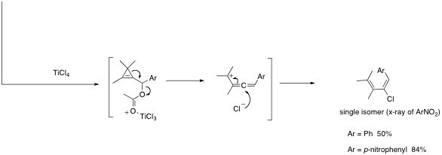
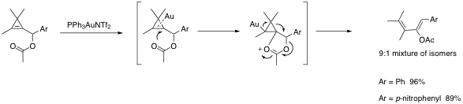
Cyclopropenes – Strain-driven Lewis-acid Mediated Rearrangements
Chris Hyland, California State University, Fullerton
π vs. σ-Lewis-acid activation
By judicious choice of Lewis-acid cyclopropenyl acetates can undergo π- or σ-activation to product acetoxy- or chlorodienes or opposite stereochemistry. These dienes are excellent substrates for Diels-Alder reaction and our next goal is to investigate tandem rearrangement/Diels-Alder reactions.
Notes:
Blank slide for drafting a body slide.

