Slide 1
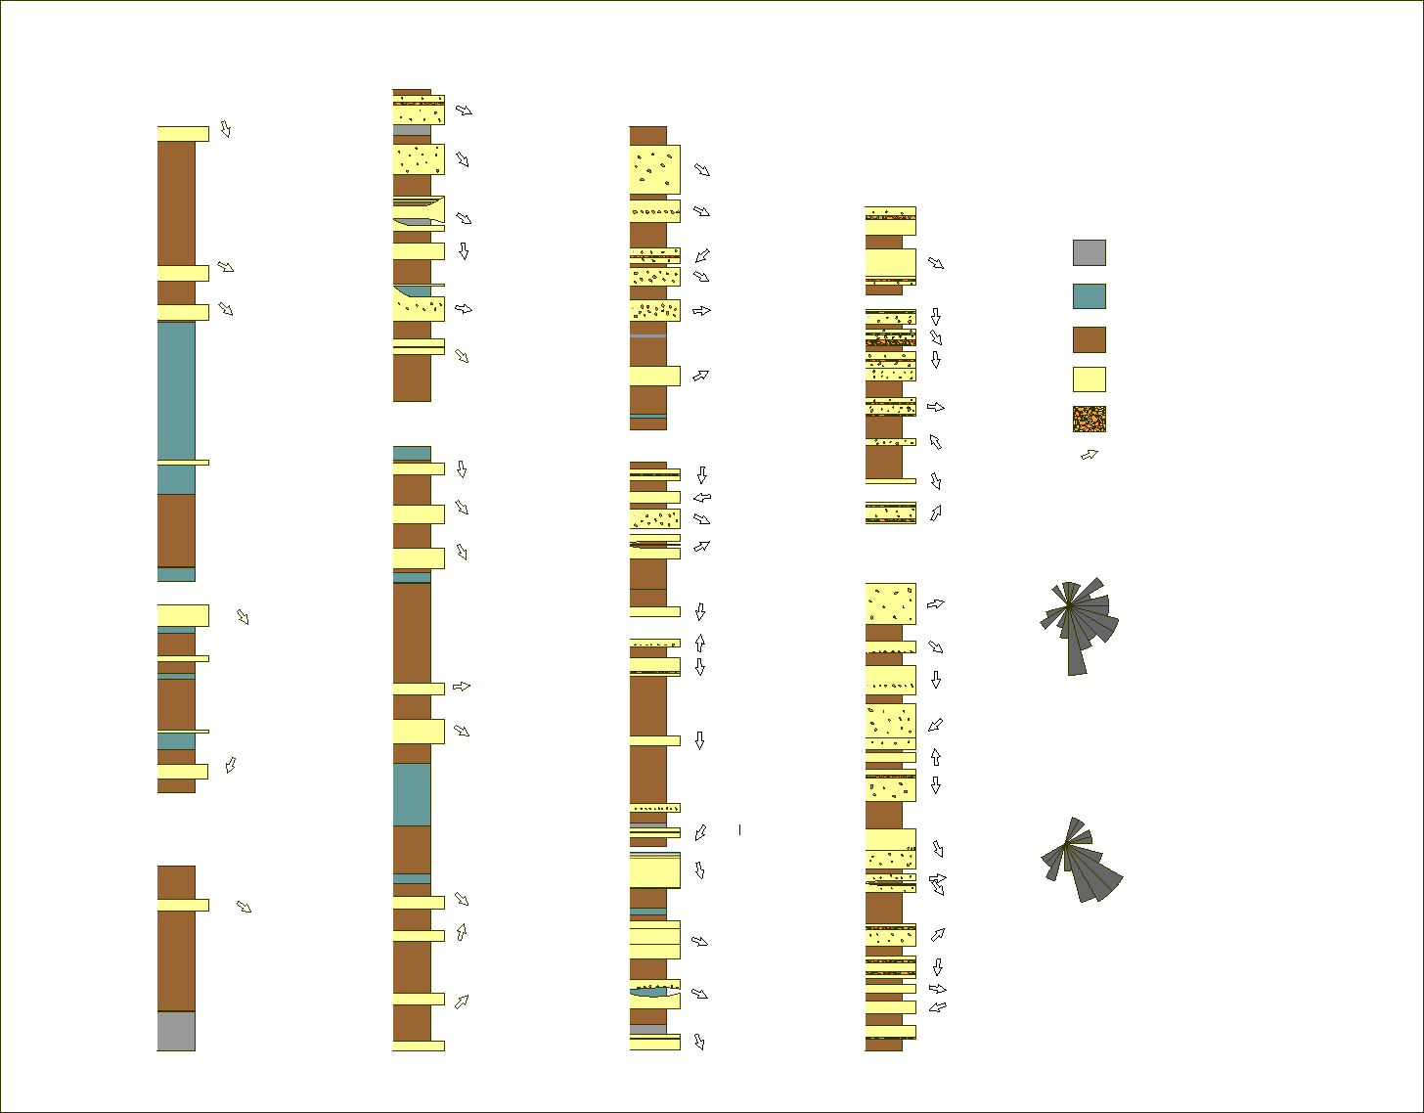
Alluvial Architecture of the Springhill Mines and Ragged Reef Formations: Fluvial Reservoir Characteristics Linked to Paleogeomorphology
Michael C. Rygel, Department of Geology, State University of New York, College at Potsdam, Potsdam, NY 13676
Although numerous studies have examined the influence of external forcing factors (climate, tectonics, and eustasy) on fluvial systems, relatively little is known about the changes is fluvial geometry and architecture that may result from natural geomorphic variability in the ancient landscape.
We are studying spectacular coastal exposures of the Pennsylvanian Joggins and Ragged Reef Formations (part of the “Joggins Fossil Cliffs” UNESCO World Heritage Site) in order to understand the role of paleogeomorphology and depositional environment in determining channel body geometry, architecture, and reservoir properties is necessary in order to fully exploit these important hydrocarbon reservoirs. During the summer of 2009 we compiled a detailed measured section through these units (right) and are compiling channel body data in an attempt to construct a basin-scale framework that links channel body geometry, architecture, and petrography to geomorphic position on the floodplain and depositional environment.

