Slide 1
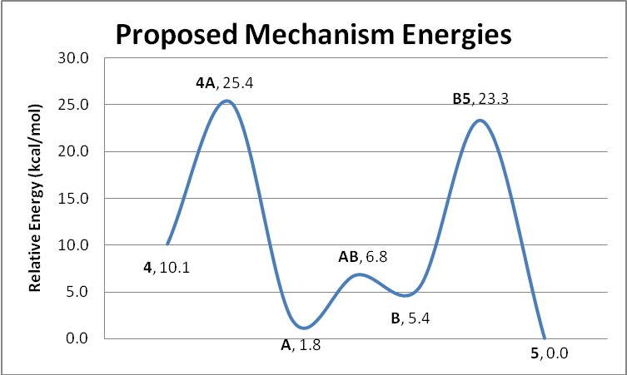
Sites of Protonation and Ligand Migration in Bimetallic Organometallic Complexes
Roger L. DeKock, Department of Chemistry, Calvin College, Grand Rapids, MI 49546
Proposed Mechanistic Steps A and B
Background/Introduction
Results
This report focuses on a computational chemistry study of the activation of the butadiene ligand by a di-iridium complex wherein the iridium atoms are bridged by the dihydrogen diphosphino methane ligand, dhpm.
The highest activation barriers are about 25 kcal/mol; this is without corrections due to solvation effects. Zero-point energy corrections do not affect these values significantly.
Conclusions
We have found that the mechanism proposed by Dr. Martin Cowie at the University of Alberta is a reasonable one.
Computational Methodology
Optimization of structures was done using the hybrid functional B3LYP . The cc-pVDZ basis set was used for most atoms, while the LANL2DZ basis set was used to generate pseudopotentials for the transition metals. To understand mechanisms, we studied transition states using Gaussian 03’s QST3 function. Using B3LYP, cc-pVDZ, and LANL2DZ QST3 uses Synchronous Transit-Guided Quasi-Newton (STQN) methods to find the saddle points.
Graph 1.

