Slide 1
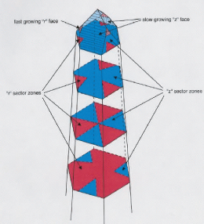
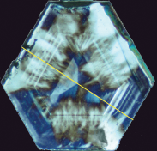
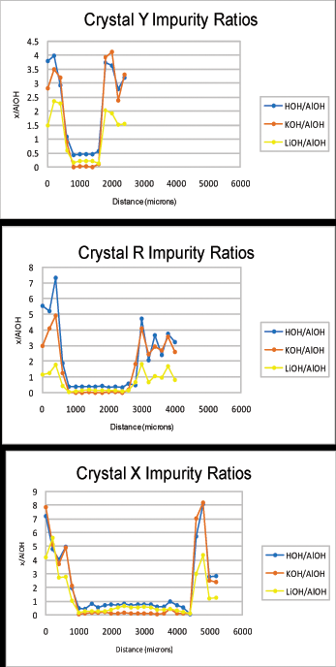
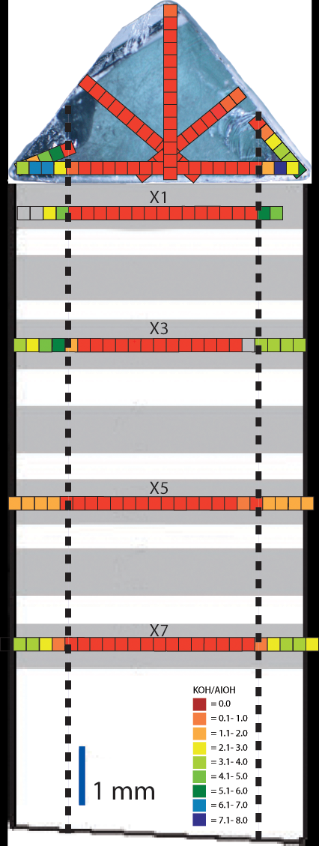
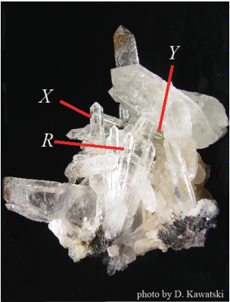
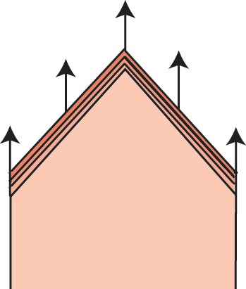
Two-Stage Growth of Hydrothermal Quartz: Impurities Quantify the Story
Phillip D. Ihinger, Department of Geology, University of Wisconsin-Eau Claire Eau Claire, WI 54701
Quartz-filled hydrothermal veins are the fossilized remnants of fluid-filled fractures that facilitate the majority of material and heat transfer within the Earth’s crust. The behavior of hydrothermal systems governs the mobility of dissolved ore species and organic compounds related to oil and natural gas formation. The evolution and timescales of hydrothermal channels are poorly known. We have recently shown the potential of micro-FTIR analyses for revealing variable growth evolutions of individual quartz crystals within veins of variable hydrothermal grade and thus for offering insights into the thermal and chemical evolution of natural hydrothermal systems...
New Findings:
FTIR analyses document a two-stage growth evolution for each crystal in the LeChang vug: an inner ‘core’ formed by growth entirely on rhombohedral faces, and an outer rind of even thickness formed by addition of material onto each of the six prism faces.
Previous Work:
Wafers cut L to c-axis of crystals from vug reveal a more complex growth evolution than that of Brazilian specimen.
IR analyses reveal 6 sector zones associated with growth on the 6 r & z rhombohedral faces of a specimen from Minas Geras, Brazil (Ihinger & Zink, 2000, Nature, 404, p 865 - 869).
FTIR analyses distinguish growth on m-faces from growth on r- & z-faces. Boundaries between sector zones align with observed optical features.
Stage 1
Stage 2
Multiple crystals were sampled from a single hydrothermal vug from LeChang, China.

