Slide 1
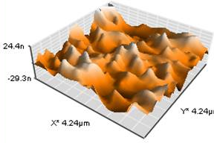
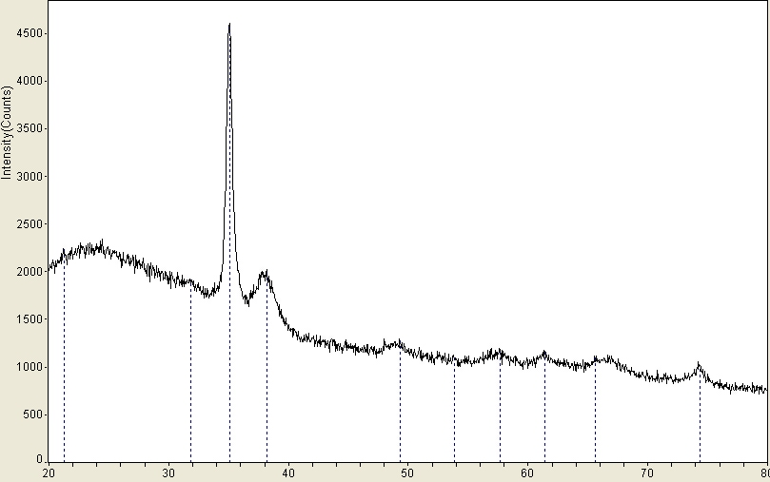
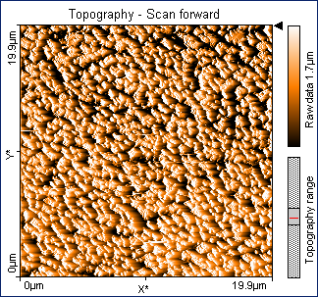
Glow-Discharge Plasma as a Synthetic Medium for Nanocrystalline Inorganic Non-Molecular Metal Oxides
Richard W. Schaeffer, Department of Chemistry and Biochemistry, Messiah College
A glow-discharge plasma has been used to synthesize polycrystalline films of binary metal oxides. Products from reactions of metallic copper and silver cathodes with an oxygen plasma have shown curiously wide ranging and unusual compositions, for example, from Cu_{(1.05)}O to Cu_{(1.22)}O in an argon rich plasma (3:1 moles Ar to O₂) to Cu_{(2.31)} to Cu_{(3.27)}O in an oxygen rich plasma (3:1 moles O₂ to Ar). The products have been analyzed using atomic absorption spectroscopy, powder x-ray diffraction, and atomic force microscopy. The reproducibility of the stoichiometry is not as good as desired, ranging between 10-30% rsd. Part of the difficulty has been the small yield of product ranging from less than 1.00 to 2.14 mg for 24-48 hour run times. Powder x-ray diffraction typically reveal a crystalline phase of CuO (tenorite) with varying peak profiles and an amorphous phase as illustrated in the plot below. The variation in peak profile probably represents differences in particle size and crystallinity. Finally, atomic force microscopy revealed an uneven “mountain range” product morphology on the surface of the substrate as illustrated in the 3-d AFM iage below. The height and diameter of the individual “peaks” were about 50 and 400 nm, respectively.

