Slide 1
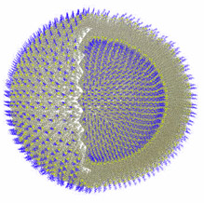
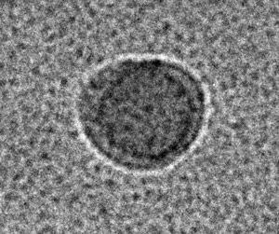
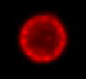
Functional Lipid Metal Complexes
Juan C. Noveron, Department of Chemistry, University of Texas at El Paso,
500 W. University Ave. El Paso, TX 79968-0513
Amphiphilic ligands with multidentate donors generated lipid metal complexes that self-assemble in water into supramolecular structures.
50 nm
H₂O
Cryo-TEM
Multidentate
Lipid Ligands
1 μm
Metallo-liposomes
Metallo-liposomes may be designed to exhibit catalytic and gene-delivery properties.
H₂O
Nile Red Stained
Fluorescent Microscopy

