Slide 1
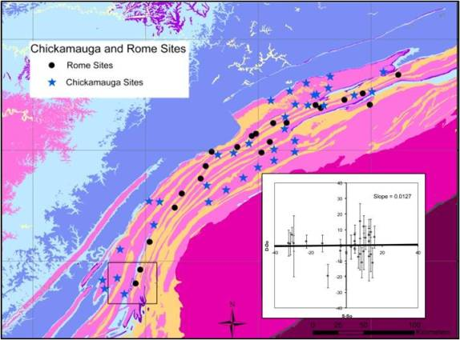
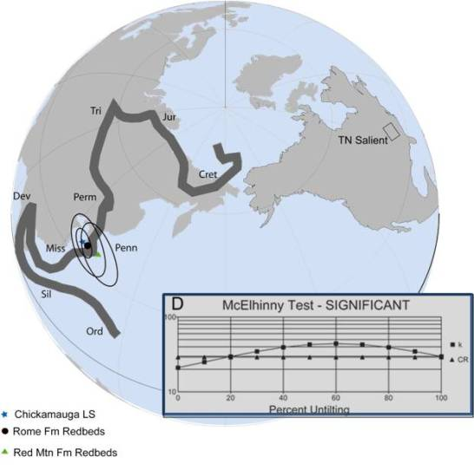
Curvature of Orogenic Fronts: A Study of the US Appalachians
Understanding fold-thrust belt curvature is an integral step in determining the evolution of a mountain belt. Paleomagnetic analyses of units in the Tennessee salient reveal syn-deformational magnetizations, acquired in the Late Carboniferous, that show no correlation between orogenic strike and magnetic declination. This implies that remagnetization was widespread in the southern Appalachians and that any potential orogenic rotation must have occurred prior to the Late Carboniferous.

