Slide 1
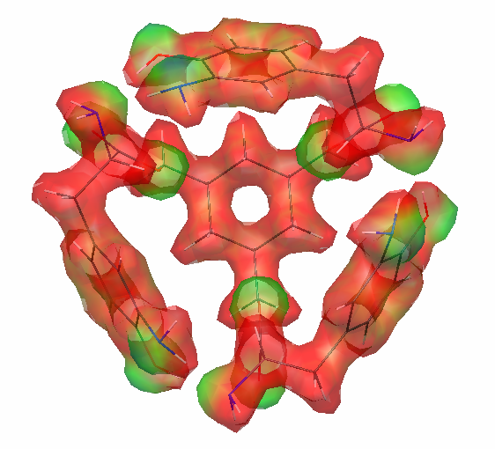
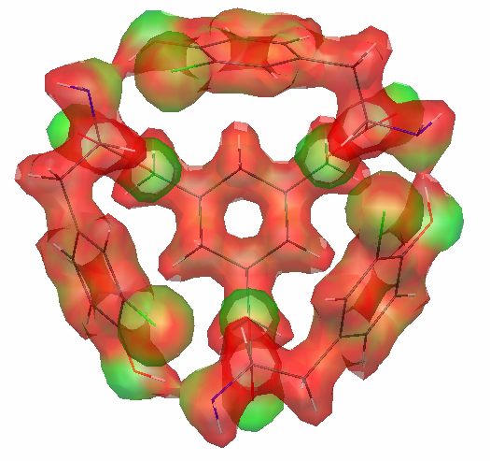
The Phenol-Amine Hydrogen Bond as a Director of Molecular Structure
Benjamin L. Miller, Department of Dermatology, University of Rochester
pH > amine pKa
pH > phenol pKa
pH < amine pKa
pH < phenol pKa
“Open”
“Open”
“Closed”:
size-dependent ion binding
Calculated structures (GAMESS: B3LYP/STO3G) for two pH-responsive receptors indicate subtle differences in cavity size and phenol-amine hydrogen bond distance. We have synthesized four new analogs, and are testing their pH-dependent ability to bind a range of metal ions, with affinities dependent in part on ion size. We hypothesize that phenol pKa differences will strongly impact this profile.

