Slide 1
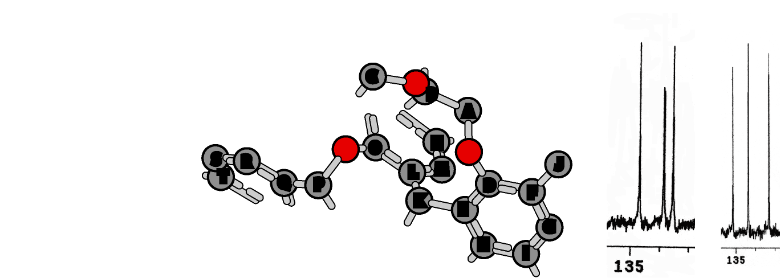
I. Computational Studies of the Cone and 1,2,3 Alt Calix[6]arene Bis-Crown-4 Isomers Meghan N. Lawson, Michael T. Blanda, Sara J. Staggs, Lauren N. Sederholm, and David C. Easter* Texas State University-San Marcos
Focus: To evaluate calculated NMR shifts, structures, bond distances and charge distributions in light of experimental data.
Symmetry-unique atoms within an isomer
C NMR

Slide 2
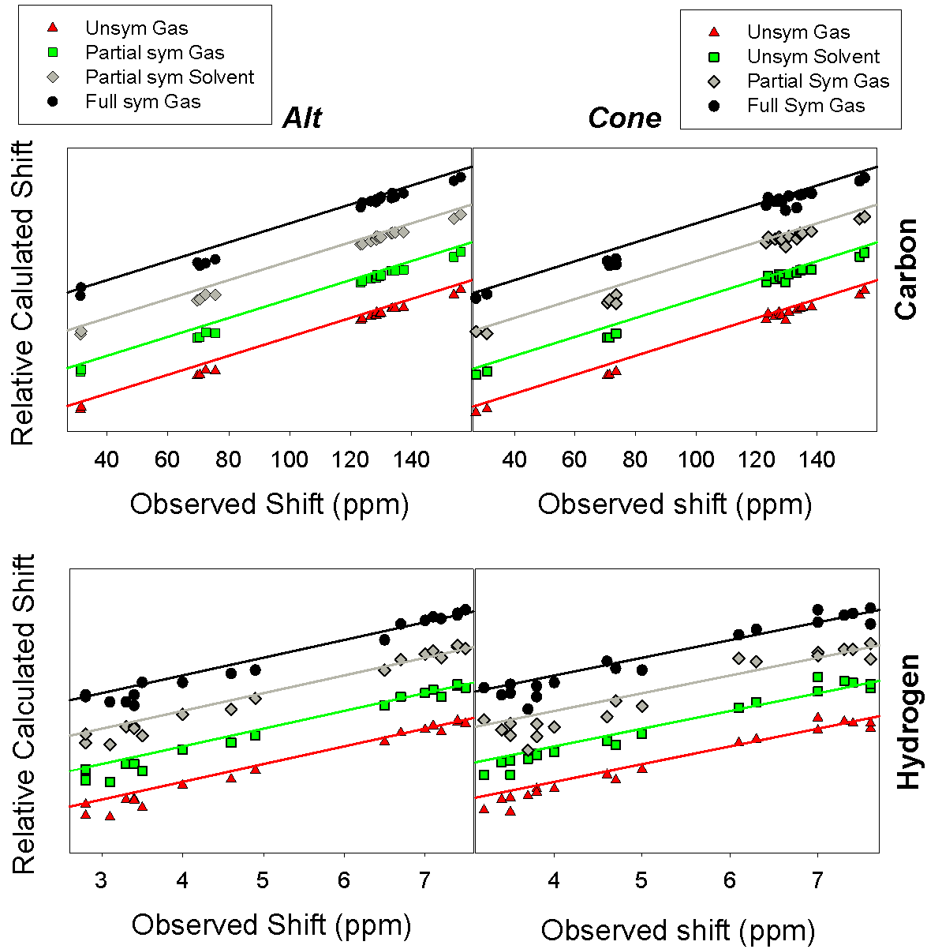
I. Computational Studies of the Cone and 1,2,3 Alt Calix[6]arene Bis-Crown-4 Isomers Meghan N. Lawson, Michael T. Blanda, Sara J. Staggs, Lauren N. Sederholm, and David C. Easter* Texas State University-San Marcos
Good agreement is observed between calculated and known NMR assignments.
Agreement is better in calculations that do not impose symmetry on equivalent atoms.
Consideration of solvent effects in calculations improves energies, but not NMR predictions.
Calculated vs. Observed NMR Shifts

Slide 3
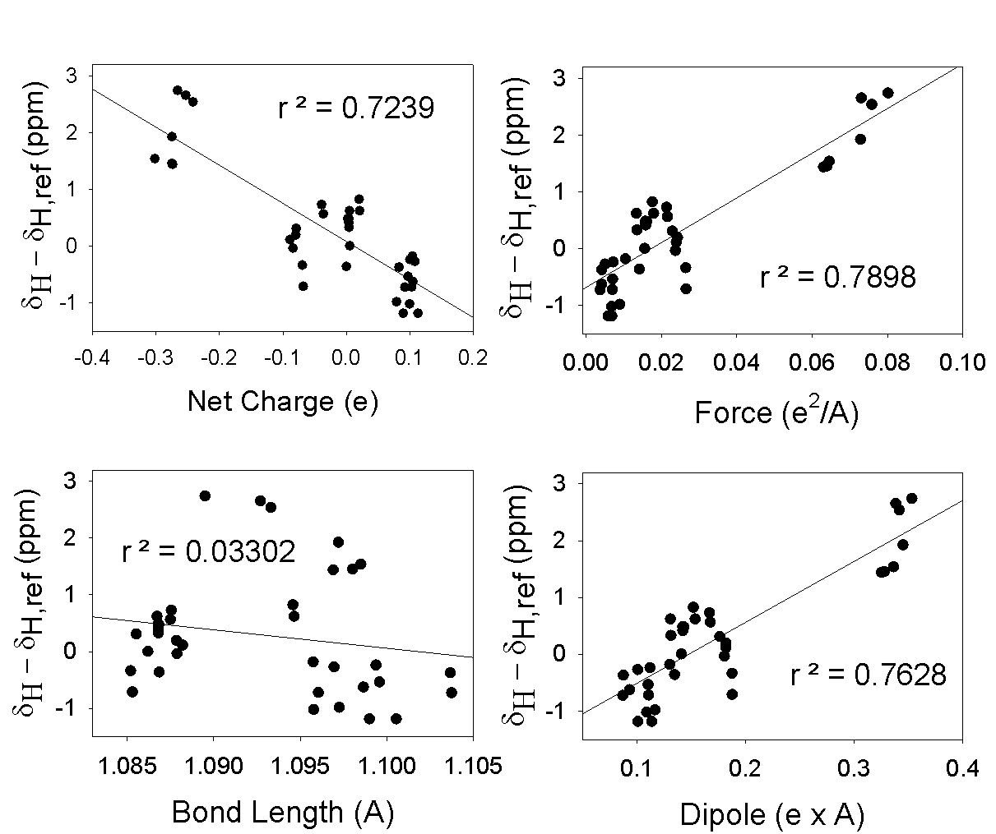
I. Computational Studies of the Cone and 1,2,3 Alt Calix[6]arene Bis-Crown-4 Isomers Meghan N. Lawson, Michael T. Blanda, Sara J. Staggs, Lauren N. Sederholm, and David C. Easter* Texas State University-San Marcos
Results:
Calculations are helpful for assigning many unknown peaks; however, some assignments remain ambiguous.
Net charges, electrostatic forces, and local dipoles (but not bond lengths) are correlated to spectral compression.
Plots investigating correlations between four factors (x-axis) and spectral compression (y-axis)

Slide 4
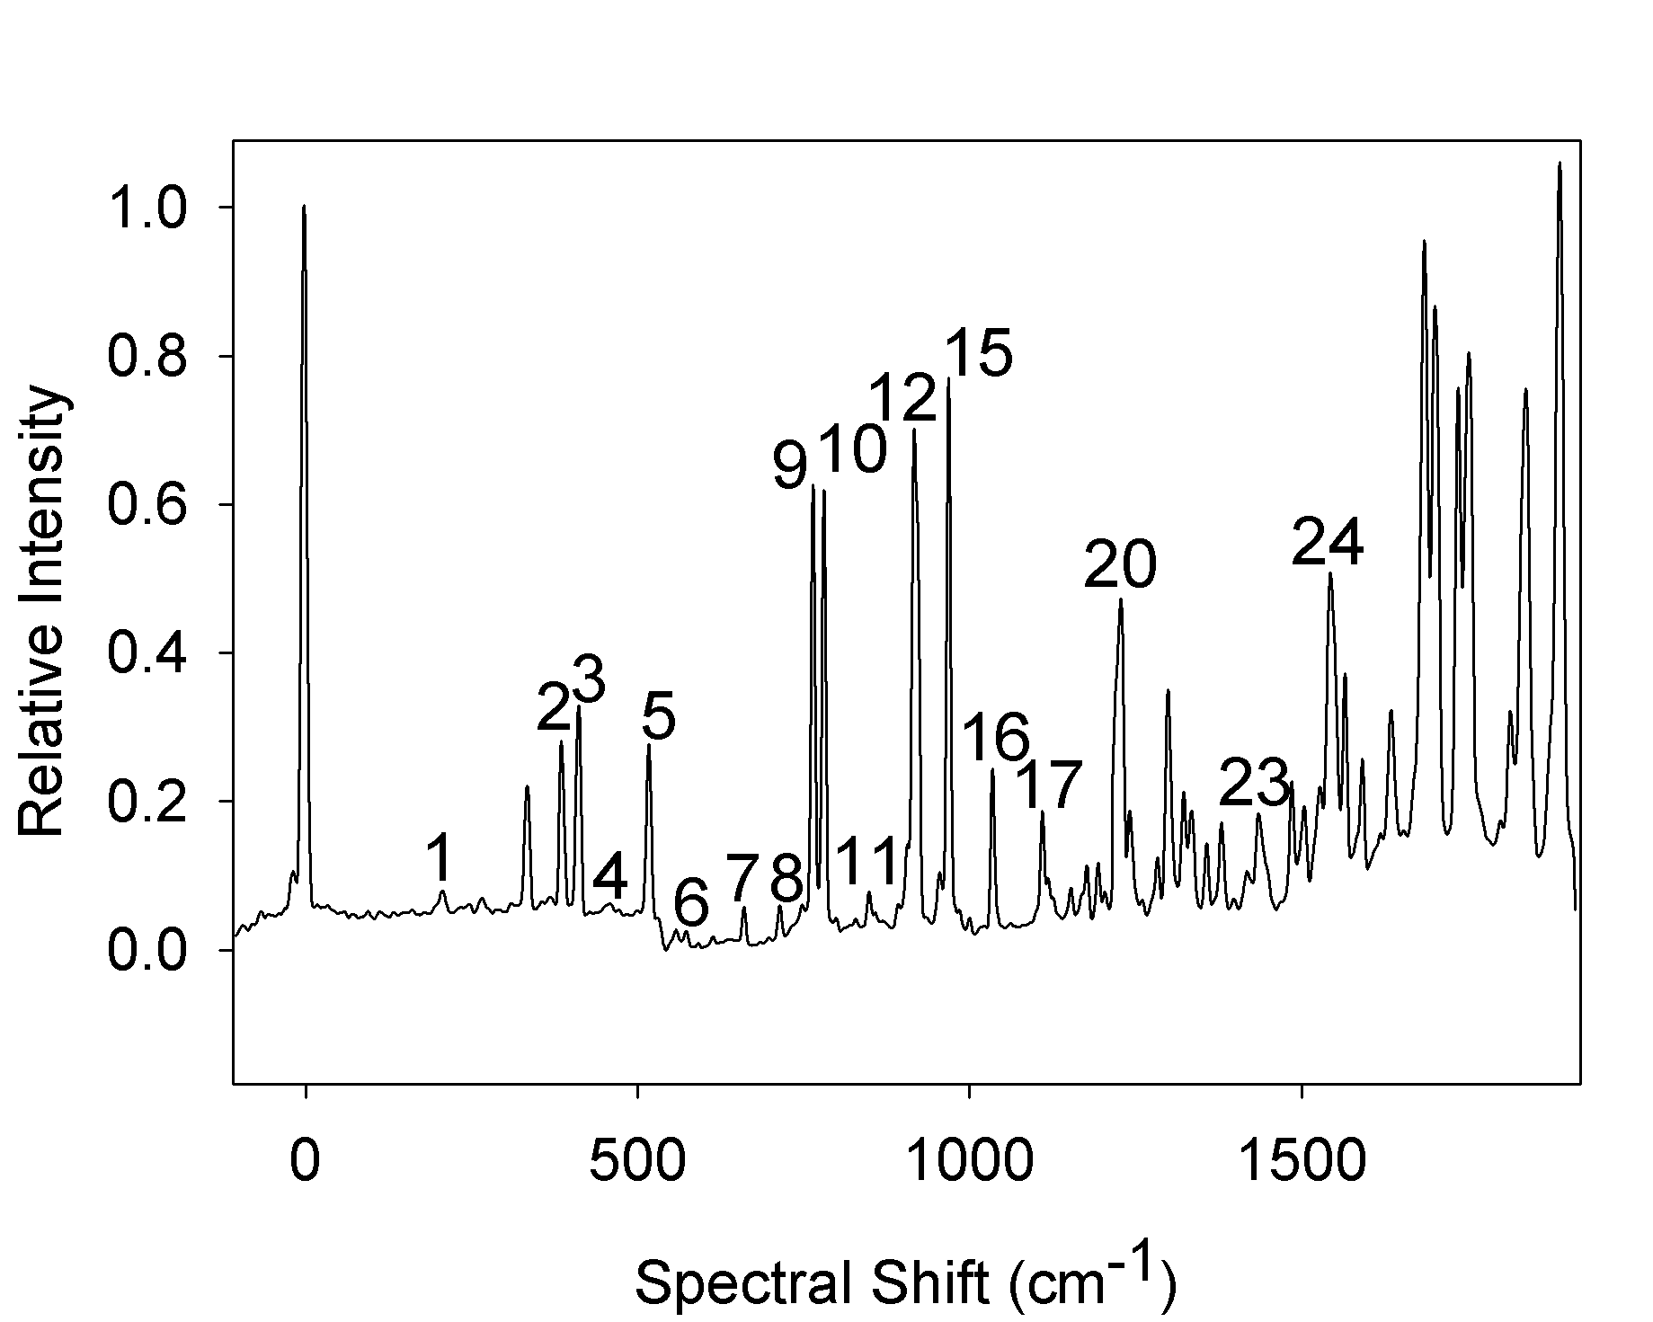
II. R2PI Spectroscopic Studies of Neat Fluorobenzene Clusters and Mixed Benzene-Fluorobenzene Clusters
David C. Easter*, Scott A. Grimes and Meghan N. Lawson
Texas State University-San Marcos
A. Fluorobenzene Monomer, C₆H₅F
R2PI Monomer Spectrum

Slide 5
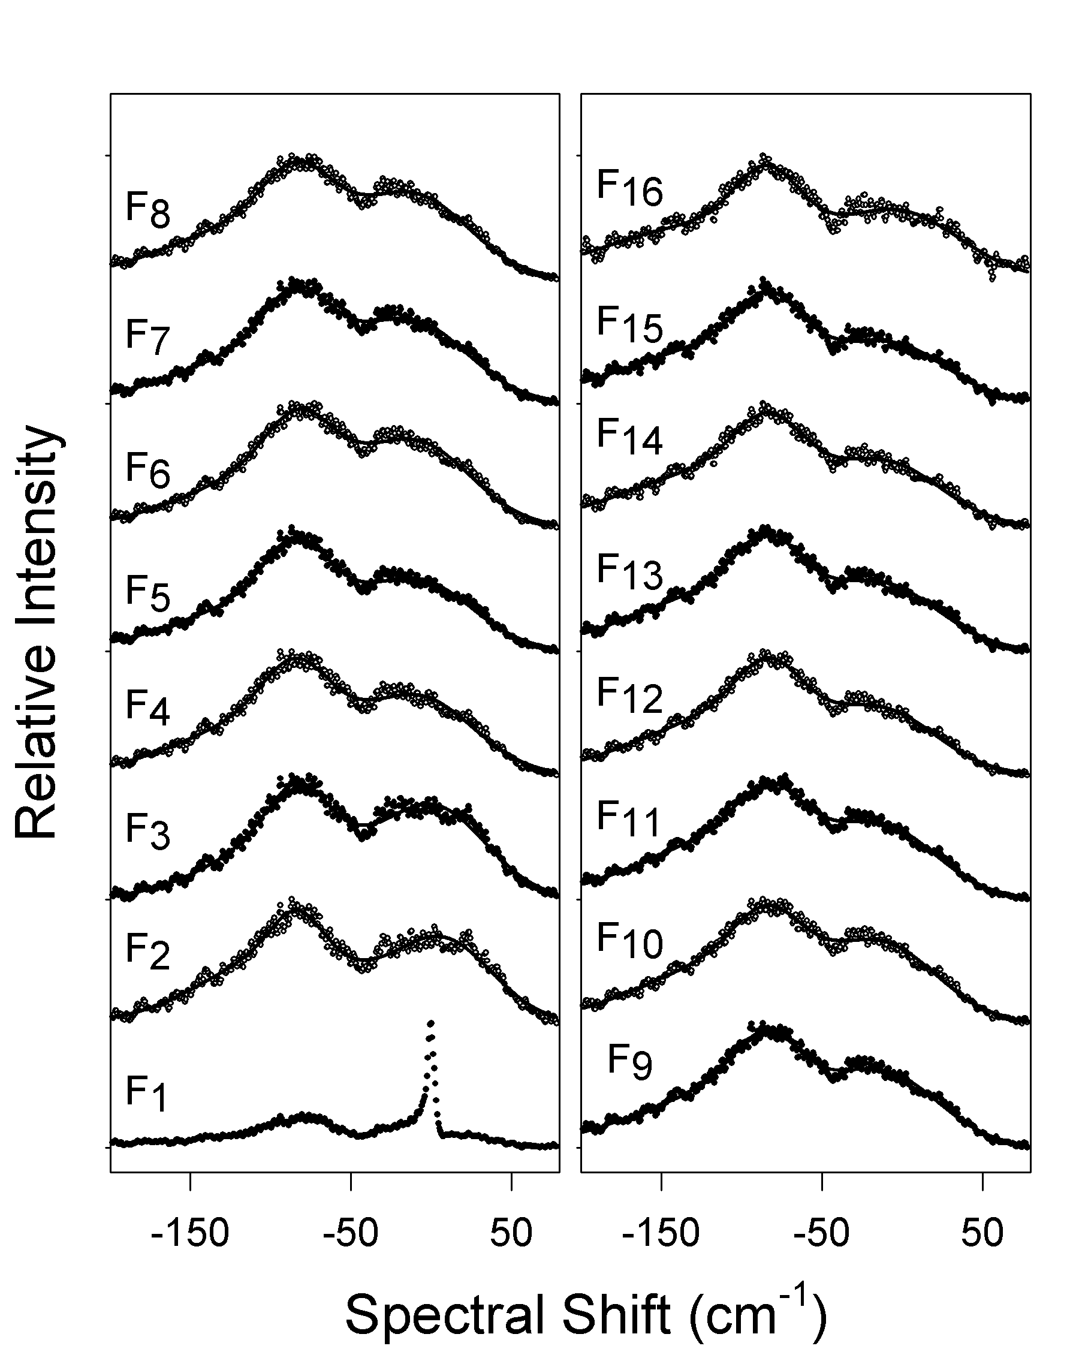
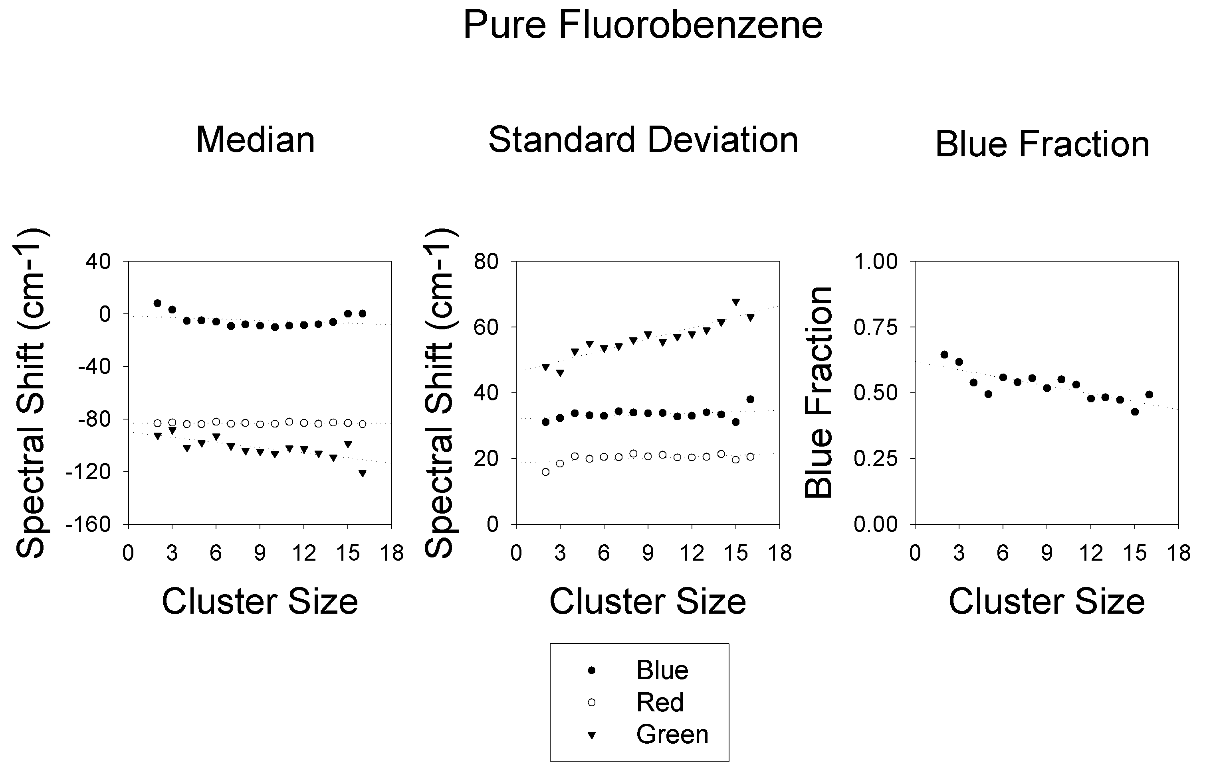
II. R2PI Spectroscopic Studies of Neat Fluorobenzene Clusters and Mixed Benzene-Fluorobenzene Clusters
David C. Easter*, Scott A. Grimes and Meghan N. Lawson
Texas State University-San Marcos
R2PI Spectra
B. Neat (C₆H₅F)_{n} Clusters
Spectra consist of three features: A red-shifted peak (∼-80 cm⁻¹), a blue-shifted peak (∼+20 cm⁻¹), and a broad feature (∼-100 cm⁻¹)
Trends with increasing size, n:
All peaks tend to broaden.
Red peak intensity increases relative to blue.
Broad underlying feature
shifts further red.

Slide 6
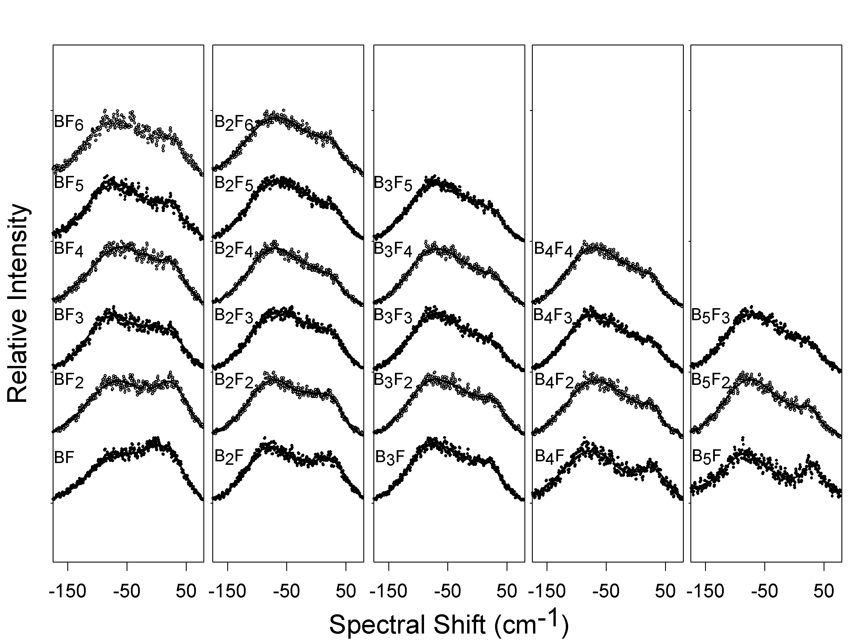
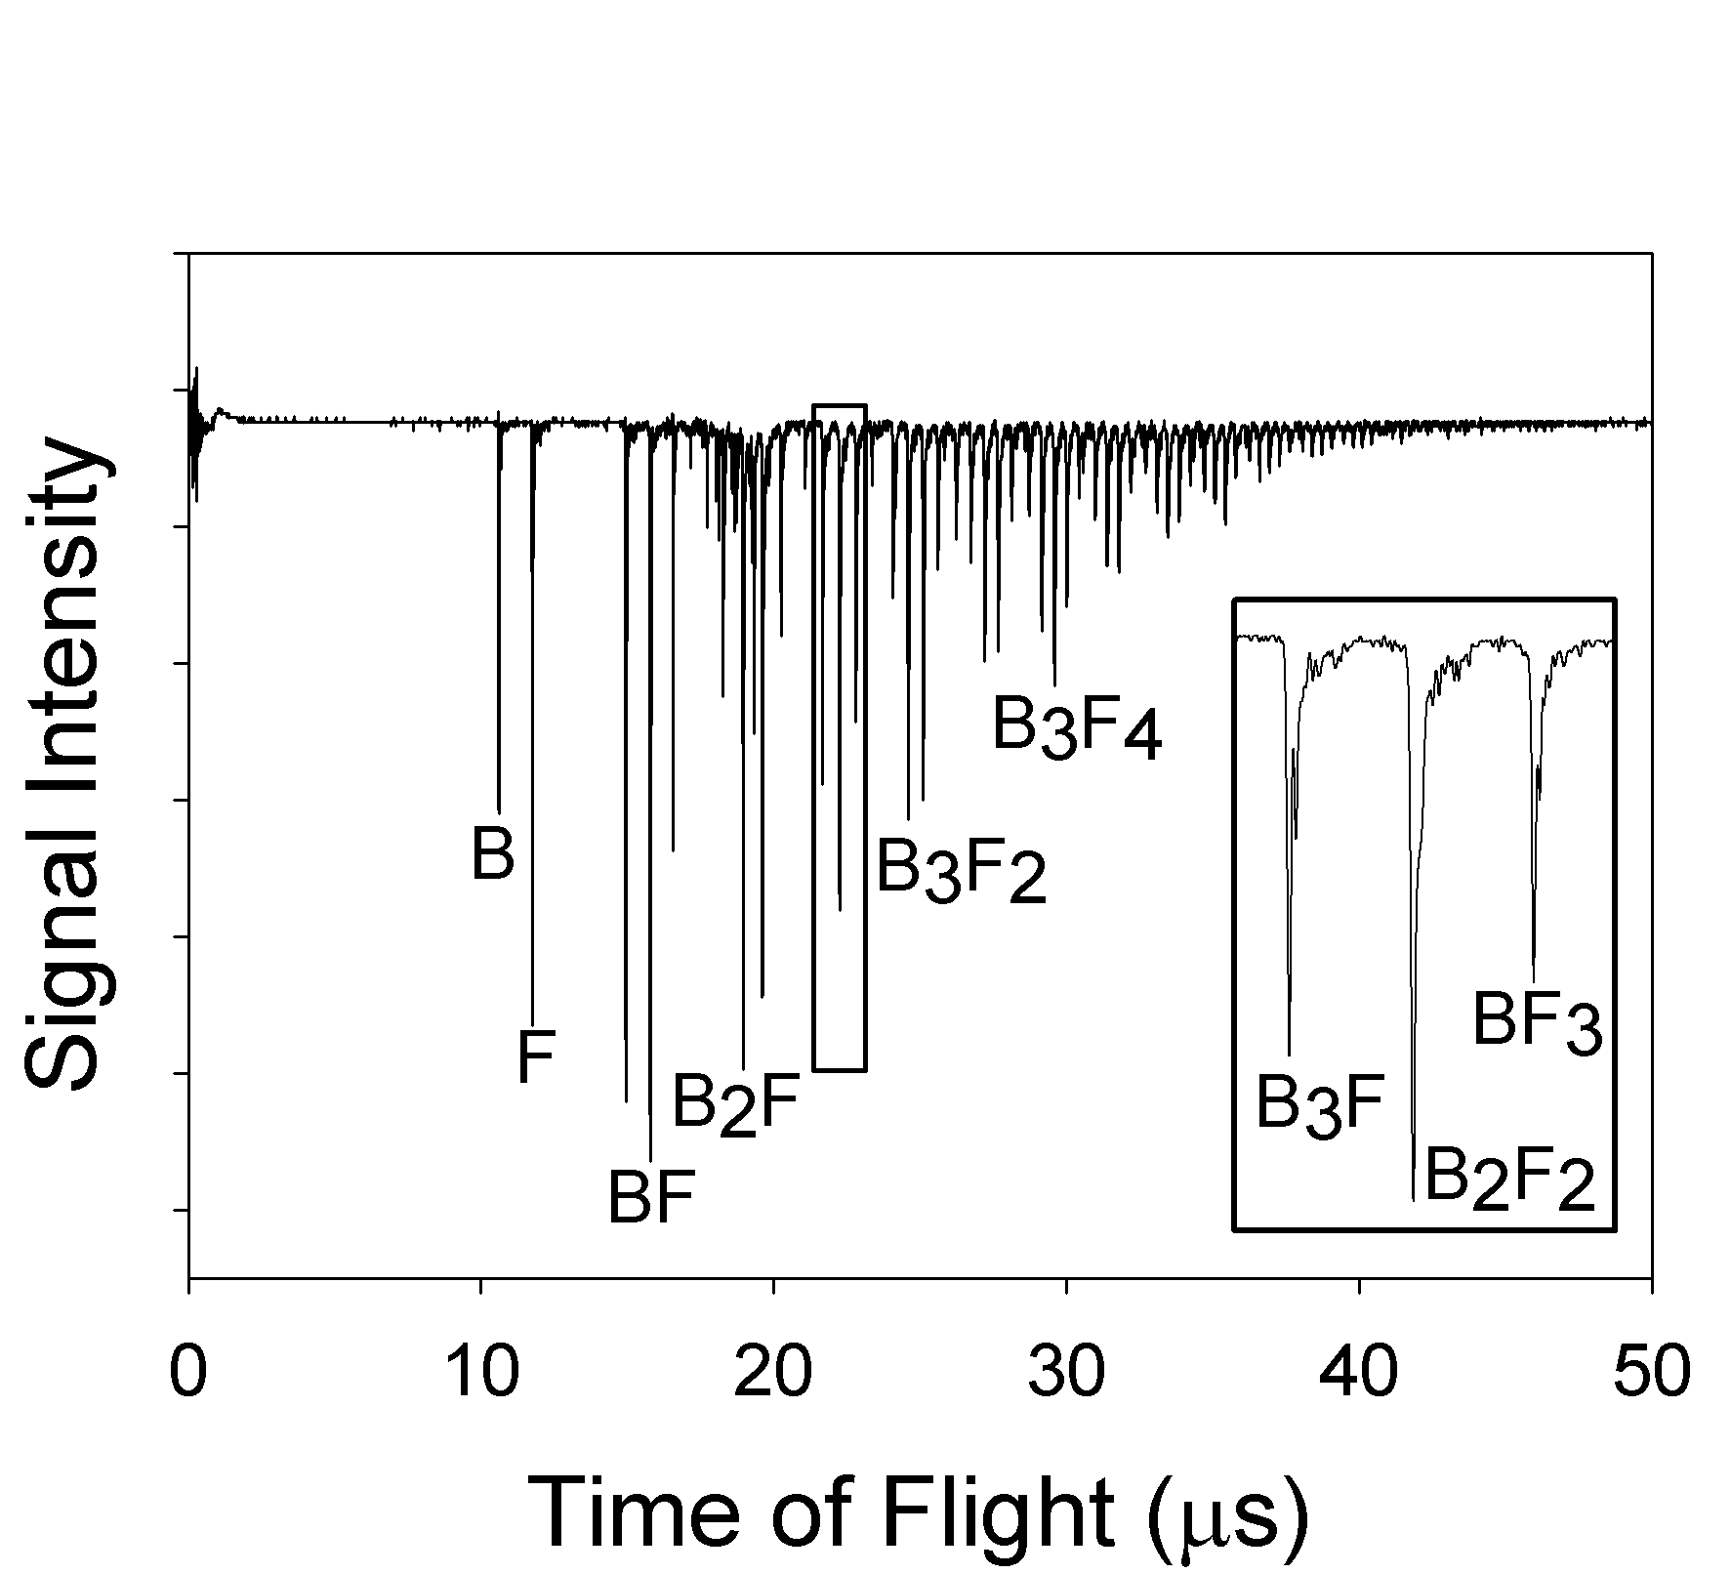
II. R2PI Spectroscopic Studies of Neat Fluorobenzene Clusters and Mixed Benzene-Fluorobenzene Clusters
David C. Easter*, Scott A. Grimes and Meghan N. Lawson
Texas State University-San Marcos
R2PI Spectra
C. Mixed (C₆H₆)_{m}(C₆H₅F)_{n} Clusters
Spectra consist of two features: A red-shifted peak (∼-80 cm⁻¹), and blue-shifted peak (∼+20 cm⁻¹).
Trends with increasing size, n:
Red peak shifts increase.
Red peak intensity increases relative to blue.
TOF Mass Spectrum

