Slide 1
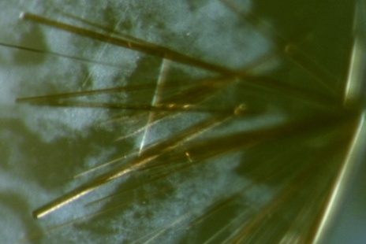
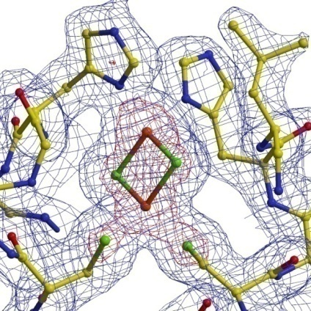
Modulation of Reduction Potentials of [2Fe-2S] Iron Sulfur clusters
Laura Hunsicker-Wang, Department of Chemistry, Trinity University,
San Antonio, TX 78211
How iron sulfur proteins modulate reduction potential is a fundamental question in biological chemistry. The factors that govern reduction potentials are thought to include the number and type of hydrogen bonds to the cluster, the number of charged residues near the cluster, and hydrophobicity of the environment around the cluster. In our work, each of the implicated factors are being tested by making site-directed mutations
and determining the resultant reduction potential in the Rieske protein from Thermus thermophilus . Conformational or electronic changes that might accompany the changes in reduction potential are ascertained through X-ray crystallographic and spectroscopic studies. Three mutations:
Y158F, G156S and L135A have been produced, which test the effect of
removing an OH-S hydrogen bond, adding a hydrogen bond, and changing
the solvent accessibility of the histidine ligands to the cluster. The tWT,
Y158F and L135A proteins all show a pH-dependence of the UV-Visible
spectrum. The midpoint of the curve is the average of the two pK_{a}’s of the
protein, which are summarized below. Each of these proteins have been
crystallized under low pH conditions. Data to 2.0 Å for tWT and L135A
have been collected and are being refined. Detailed analysis of the low
pH structure versus the published high pH crystal structure is underway.
A collaboration to measure the reduction potentials of all mutants
has been established and measurement s are
being made. CW-
EPR spectra of all
samples have also
been collected.
tWT A₄₃₆ versus pH
Midpoint = 8.8
A₄₃₆
pH
pH dependence of the UV-Visible spectrum.
Mutant pK_{a}
L135A 9.2
Y158F 9.4
tWT crystallized at low pH (6.5)
Space group P2₁2₁2
Pr³⁺ as additive,
4 unique Pr³⁺ sites located
2.0 Å electron density map for tWT

