Slide 1
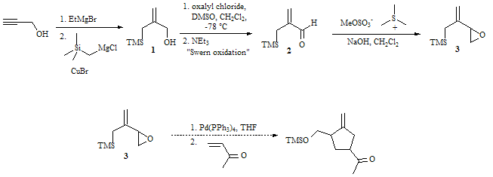
Synthesis of a New Epoxide Precursor for Pd(0)-Catalyzed [3+2] Cycloaddition Reactions
Rings are extremely important structural units in many essential organic molecules. Molecules like Vitamin C, the chemotherapy drug Taxol® and the antibiotic penicillin are well known examples that have been a tremendous benefit to society. Because of the extreme significance of molecules like these, it is imperative that organic chemists develop synthetic reactions that can be used to generate ring structures in organic molecules. One highly successful means of accomplishing the synthesis of 5-membered carbon rings is the use of Trimethylenemethane intermediates. This proposal seeks to expand the utility of this important synthetic protocol by using novel starting materials (like compound 3 below) to generate more complex and highly functionalized ring-containing products. This new synthetic protocol would then provide synthetic organic molecules with another method of synthesizing important compounds.

