Slide 1
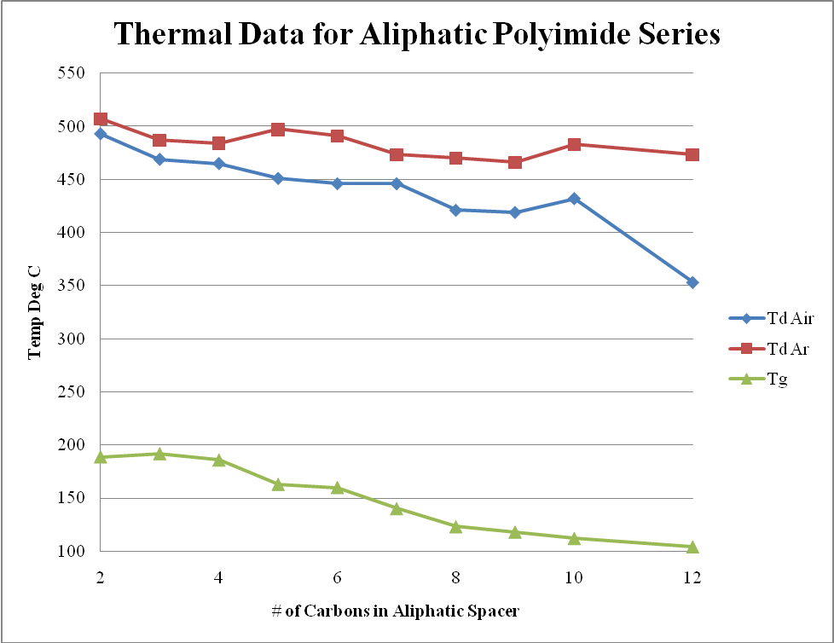
NEW MEMBRANES FOR ENHANCED PURIFICATION OF NATURAL GAS AT THE WELLHEAD
Chad J. Booth & Patrick E. Cassidy, Texas State University – San Marcos
ACS-PRF Grant #46763-B7
The project goals are to examine a series of aliphatic polyimide films and their subsequent TiO₂ nanocomposites for potential use as a purification membrane for natural gas. During the first year of the project we were able to complete the synthesis of the homologous aliphatic polyimide series and have collected the thermal/mechanical data (shown below) on these materials. We are currently collecting the gas permeation data for the native homologous series as well as beginning the synthesis of the TiO₂/polyimide nanocomposites.

