Slide 1
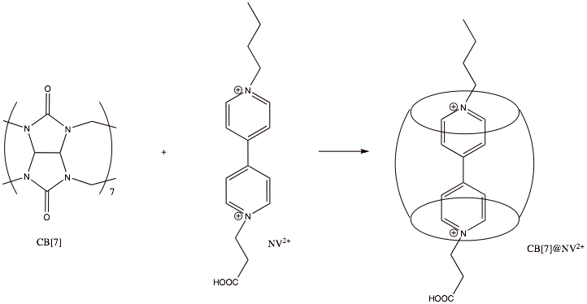
Study of aggregation of organic dyes on metal oxide nanoparticle surfaces
Elena Galoppini RutgersUniversity /Newark
Metal oxide nanoparticles with bound organic dyes find applications in electrochromic displays, dye-sensitized solar cells (DSSCs), and other devices. We have developed two strategies to study dye ”insulation” effects (a) the use of tripodal linkers having a large footprint (Dye-tripod) to control the spacing between molecules and (b) the encapsulation of dyes in host molecules that bind to the surface (Dye@host).
We synthesized and studied the binding and photophysical properties of large footprint tripodal pyrene derivatives bound to TiO₂ and ZrO₂ semiconductor nanoparticles films through meta or para oriented anchoring groups
(b) The binding of viologens directly bound or bound as viologen@cucubituryl complexes to TiO₂ and ZrO₂ thin films was studied. We observed that the chemisorption of CBs and MV@CB[7] complexes onto nanocrystalline TiO₂ is possible. Photochromic cells exhibiting reversible color changes and reversible redox chemistry are currently being tested.

