Slide 1
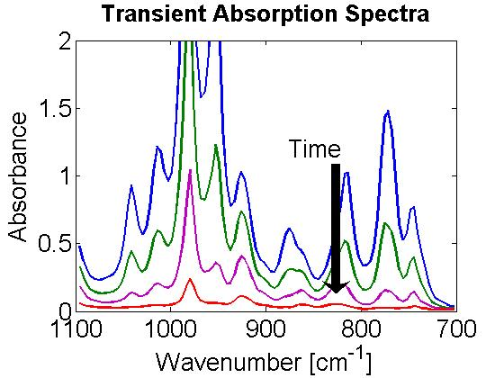
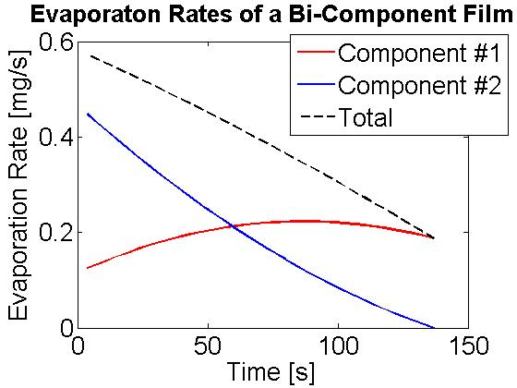
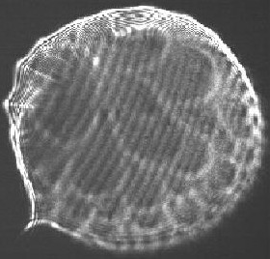
Experimental Study of Transport Phenomena and Film Instabilities of Evaporating Multicomponent Fuel Films
Peter Kelly-Zion and Christopher Pursell, Trinity University, San Antonio, TX
Many practical applications involve the evaporation of liquid films, for example toxic spill abatement, coating and painting, and drying. Our focus is on the evaporation of multicomponent fuel films because of the effect that fuel films inside internal combustion engines have on pollutant emissions and engine performance. As a film evaporates, its overall composition can change due to the preferential evaporation of the more volatile components. Both temperature and composition gradients are induced in the film and the physical properties may vary in both time and space. Also, bulk circulatory flow in the film can occur due to non-uniform density or surface tension. The general goal of this research is to elucidate the complex coupling between thermal and mass transport processes during the evaporation of multicomponent films.
Transient Film Composition Measurements
The transient film composition is measured quantitatively through calibrations of FT-IR measurements.
Film Imaging
Imaging techniques are used to measure evaporation flux, surface area, film thickness, vapor concentration distribution; and to monitor internal circulation in the film.
Film
A film is generated on a ZnSe window in the center of the Cu substrate
Schlieren image of an evaporating film
Cu Substrate (central aperture)
Liquid film
Vapor cloud
Film viewed in profile
The infrared light from the FT-IR is directed vertically up through both the substrate and the film. Absorption values in specific frequency bands are used to compute the mass and evaporation rate of each component in the film.
For some conditions, what appears to be organized cell structures may be seen. These structures may be caused by internal circulation within the film.
Film viewed from above
Structures grow and move outward toward the perimeter as new structures develop.

