Slide 1
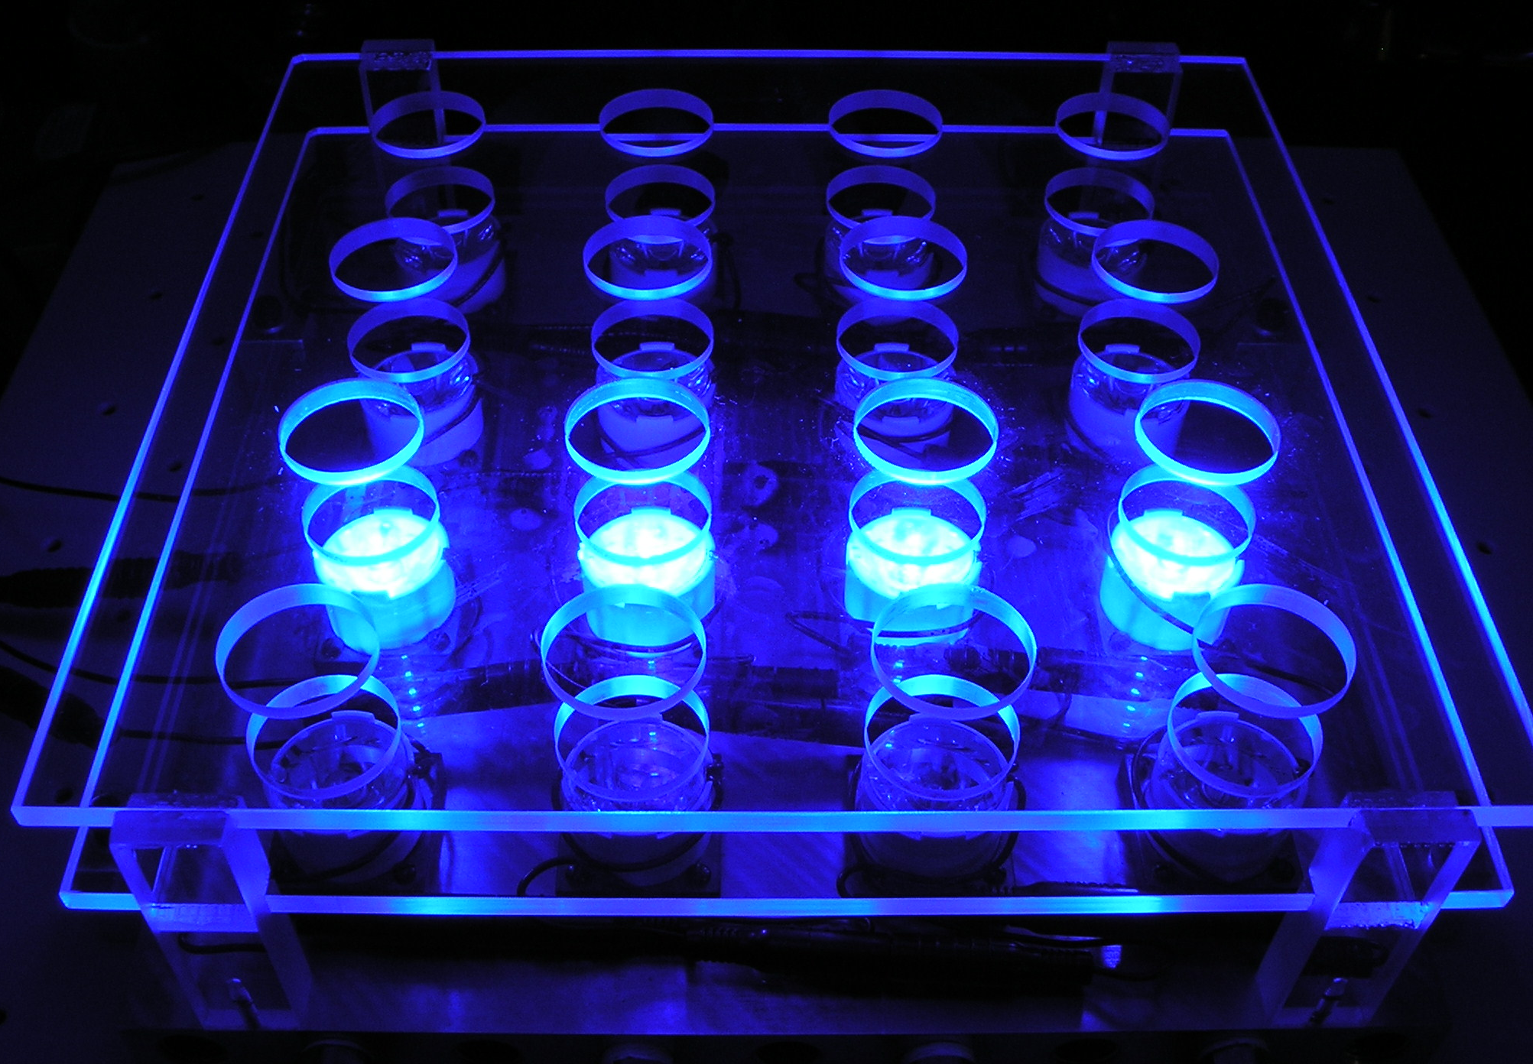
Rational self assembly of macromolecular arrays for optimized light harvesting and photocatalytic hydrogen production
Jonas I. Goldsmith, Department of Chemistry , Bryn Mawr College, Bryn Mawr, PA
Sac
ER
PS⁺
1/2 H₂
Sac⁺
PS*
ER⁻
PS
H⁺
Hydrogen production using a photosensitizer (PS) and electron relay (ER) to reduce H⁺ to H₂ and a sacrificial reductant (Sac) to regenerate PS.
Bipyridine-thiol ligand has been synthesized. When incorporated into transition metal complexes, it will allow PS and ER to form self-assembled monolayers.
Fluorescence quenching and hydrogen production experiments (using photoreactor at left) have identified promising PS/ER combinations.
Ruthenium-based PS with thiol-bipyridine has been synthesized. Kinetics and thermodynamics of adsorption on Pt and on Au surfaces have been examined electrochemically.

