Slide 1
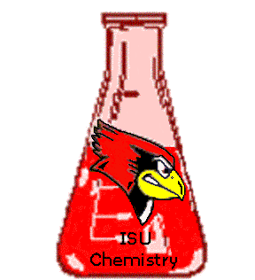
A Reactive Vanadium(III) Complex for Ligand Exchange
Craig C. McLauchlan, Illinois State University
ACS-PRF 46064 B3
Layered vanadium phosphates (VOPO₄’s) are used industrially as solid state catalysts to oxidize hydrocarbons. These catalysts are extended structures that function well, but the catalytic mechanism is not well understood. A molecular catalytic species can be more easily studied through conventional techniques. Our model system is based on the CpPCo⁻ ligand shown. The reactivity and oxidative catalytic ability of the center (“hub”) complex have been investigated and the hub shows promise as a starting point for many complexes. In pursuing vanadium coordination chemistry, this project focused on materials and catalysis and another parallel project involves bio-mimetic activity of V complexes. These topics have been chosen with student interests and education in mind in that they each expose students to a variety of synthetic and characterization techniques while pursuing some intriguing chemical problems.
Weberski and McLauchlan Inorg. Chem. Commun. 2007

