Slide 1
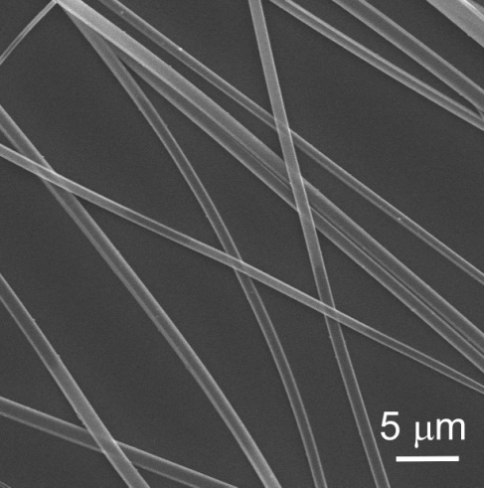
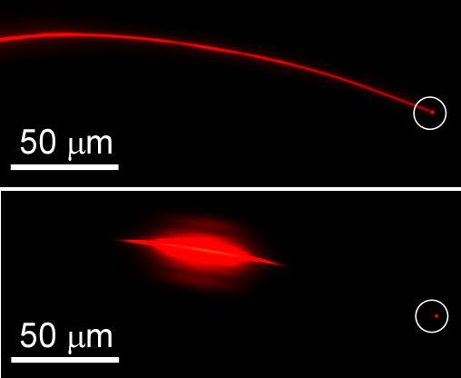
One-dimensional Exciton Diffusion in Perylene Based Solar Cell Materials
PI: Ling Zang
Department of Chemistry and Biochemistry, Southern Illinois University.
Since August 2008, Department of Materials Science and Engineering, University of Utah.
1D self-
assembly
1D optical
property
Through integrated molecular design, synthesis and engineering, well-defined single crystalline nanobelts with strong fluorescence emission were fabricated from a perylene tetracarboxylic diimide (PTCDI) molecule. PTCDIs form a unique class of n-type semiconductor materials that have widely been employed in various photovoltaic devices. Because of the one-dimensionally dominant stacking of the molecules, the nanobelts thus fabricated demonstrate highly efficient uniaxial optical properties like linear polarized emission and self-waveguided emission as shown in the optical microscope image. The observed uniaxial optical properties are shape-persistent (e.g., with minimal bending lose for the waveguide), making the nanomaterials ideal for application in the solar cells or other optical devices, where flexible, conformal materials in accommodating with the device geometry is often demanded.

