Slide 1
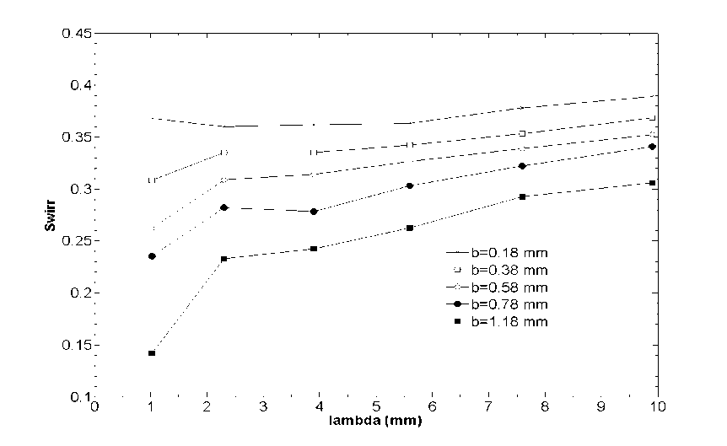
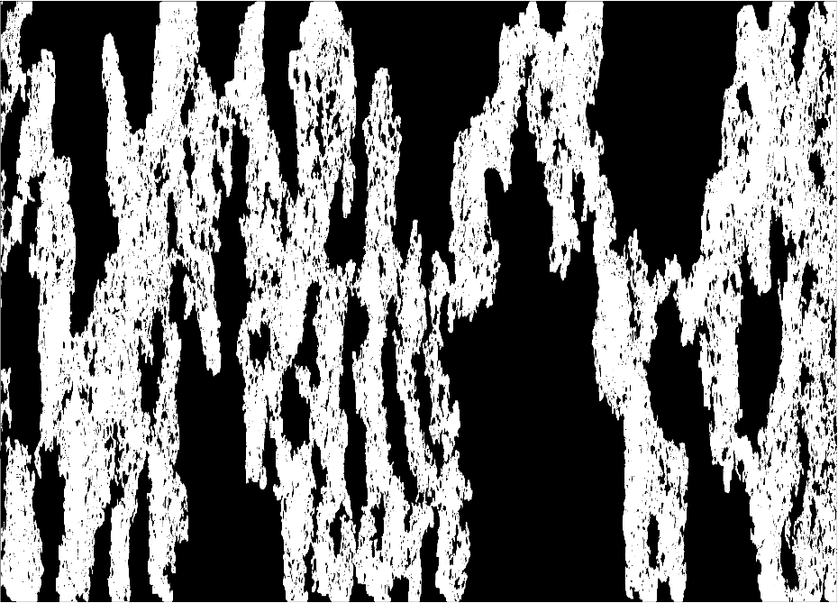
ESTIMATION OF MACROSCOPIC FRACTURE TRANSPORT PROPERTIES FROM MICRO-SCALE FLOW STRUCTURES AND FRACTURE GEOMETRY
Zuleima T. Karpyn, Department of Energy and Mineral Engineering
The Pennsylvania State University
Fluid distribution in a rough fracture
Capillary characteristics of fractures
Experimental
MIP model
This is a comparison of fluid distribution maps from experimental observations (TOP) and modeled results using the proposed Modified Invasion Percolation (MIP) approach (BOTTOM). Large aperture regions are preferentially occupied by oil in white, while water resides in the small apertures in black. Fracture dimensions are 24.5 mm wide, 100 mm long, and 0.548 mm mean aperture.
The graph shows irreducible water saturation (Swirr) as a function of spatial correlation length (lambda), for mean apertures (b) ranging from 0.18 to 1.18 mm. We analyze the effect of fracture morphology on fracture capillary characteristics, such as Swirr and capillary entry pressure, by modeling synthetic fracture cases with controlled/known structural features.
Results form this work demonstrated that the shape of a fluid front developed inside a fracture depends on the relative dominance of the aperture variability, which tends to roughen it, and the fluid front curvature, which tends to smooth it. In addition, mean fracture aperture was found to inversely affect irreducible water saturation, large mean apertures provide preferential channels for oil to flow. At a narrow ranges of standard deviation, fractures resemble the parallel plate model. Finally, a large spatial correlation length indicates a tendency for high connectivity, causing an increase in Swirr as oil preferentially flows along highly correlated pathways.

