Slide 1
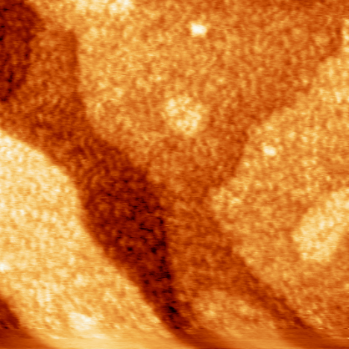
Atomically Resolved Reaction Dynamics Involving Catalytically Active, Surface Supported Clusters
Thomas P. Pearl
Department of Physics, North Carolina State University, Raleigh, NC 27695-7518
Ultra-high vacuum scanning probe microscopy enables us to explore reaction mechanisms, pathways, and energetics for heterogeneous catalysis associated with metals supported on ferroelectric materials. Thin metallic layers are currently being studied on single crystalline, uniformly poled, ferroelectric surfaces with plans to extend to other catalytically active systems. Density functional theory calculations are being considered to model the adsorption thermodynamics as well as surface reaction cross-sections.
Approximately one monolayer of Au deposited on LiNbO₃(0001) from UHV electron bombardment based evaporator source with a base pressure at 2.0 x 10⁻¹⁰ Torr. Sample annealed post deposition in UHV at ~250°C. Non-contact atomic force microscopy images recorded with Mikromasch DP15 cantilever with f_{resonance}~300KHz and a force constant ~40N/m.
Large image: Au/LiNbO₃ (0001), image area: 300 nm x 300 nm
Inset image: Monatomic steps (2.5 Å height) resolved for clean surface prior to deposition, image area: 1 μm x 1μm

