Slide 1
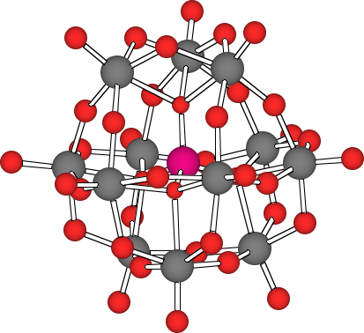
Improved Oxygen Reduction Cathodes Using Polyoxometalate Cocatalysts
PI: C. Shannon, Auburn University
Taking oxygen reduction as our paradigm case, can polyoxometalate (POM) nanoparticle hybrid thin films provide insight into the behavior of multimetallic electrocatalysts?
O₂ + 4e– + 4H⁺ === 2H₂O (1)
2M + O₂ === 2MO (2)
2MO +4e– + 4H⁺ === 2H₂O (3)
Hybrid NP/POM films prepared using LbL assembly are ‘modular’, offering the possibility to study a wide variety of POMs and nanoparticles using the same thin film architecture.
YES! POMs with weaker M-O bonds (Co) exhibit a greater influence on oxygen reduction at Au surfaces (i.e., a more positive shift of the potential) than POMs with stronger M-O bonds.
ORR specific activities of about 7 mA/cm² have been observed, exceeding the activity of commercial Pt/C catalysts by an order of magnitude
Sankarraj, Ramakrishnan, Shannon, Langmuir, 2008, 24, 632; Xin, Shannon, Langmuir, submitted.

