Slide 1
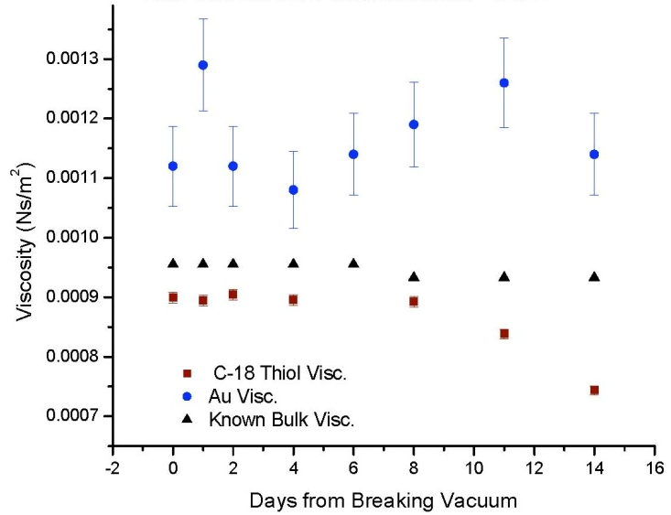
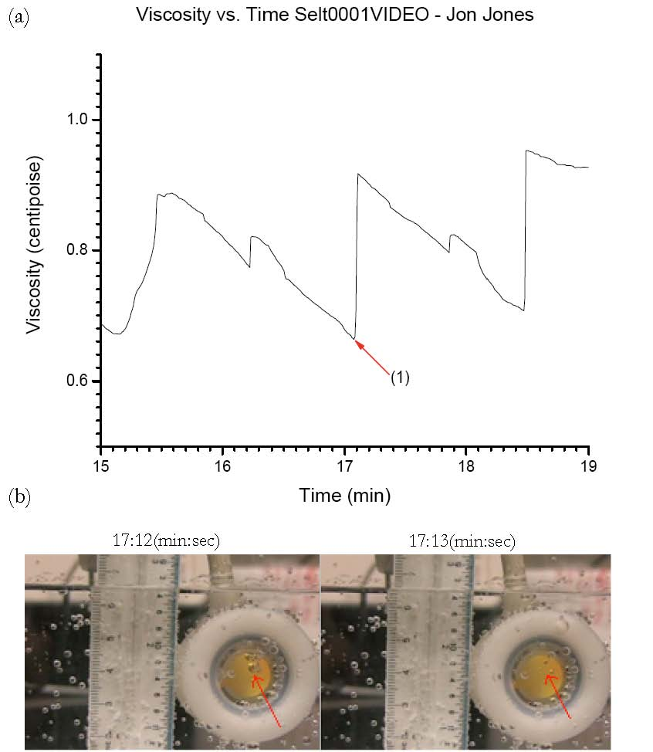
The effects of small surface roughness and nanobubbles on quartz crystal microbalance measurements
Tonya Coffey, Dept. of Physics and Astronomy, Appalachian State University
Recently there has been much interest in the presence nanobubbles on solid surfaces submerged in liquids. Our study shows that macro- and nanoscale bubbles can be detected by Quartz Crystal Microbalances (QCM) submerged in liquids. QCM’s are high quality factor oscillators that generate a shear wave when submerged in a fluid. The damping of the oscillation by the fluid causes the resonance frequency of the QCM to shift, and a viscosity can be calculated from the frequency shift. We show that when bubbles cling to the hydrophobic QCM face the viscosity of the liquid as measured by the QCM will be reduced from the true bulk viscosity of the liquid. The bulk and interfacial viscosities differ due to the short penetration depth of the QCM’s shear wave into the liquid.
The seltzer water below has visible macro-scale bubbles, and so we were able to correlate video acquired of the hydrophobic QCM submerged in the seltzer water with the viscosity data to directly link the presence or absence of a bubble to a change in the measured viscosity. Here we see a bubble popping, resulting in an upward jump in the interfacial viscosity.
In order to examine the effects of nano-scale bubbles, we vacuum distilled de-ionized water, and then measured its viscosity with both a hydrophilic (Au) and hydrophobic (octadecanethiol) QCM for 2 weeks after breaking vacuum. Like the macrobubbles, the nanobubbles present in the distilled water cause a reduced measured interfacial viscosity. This viscosity drops as time increases due to the resaturation of air into the distilled water. Interestingly, the interfacial viscosity measured by the hydrophilic crystal was always higher than the known bulk viscosity of water at the given temperature. The cause of this increased viscosity is unknown. Possibilities include an increased water density due to the very hydrophilic surface or small surface roughness effects.

