Slide 1
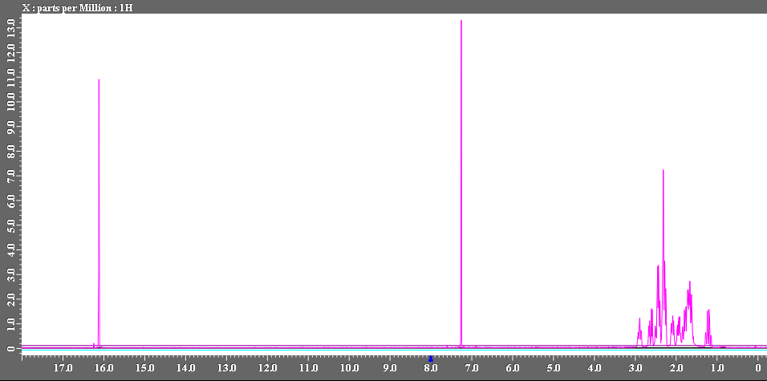
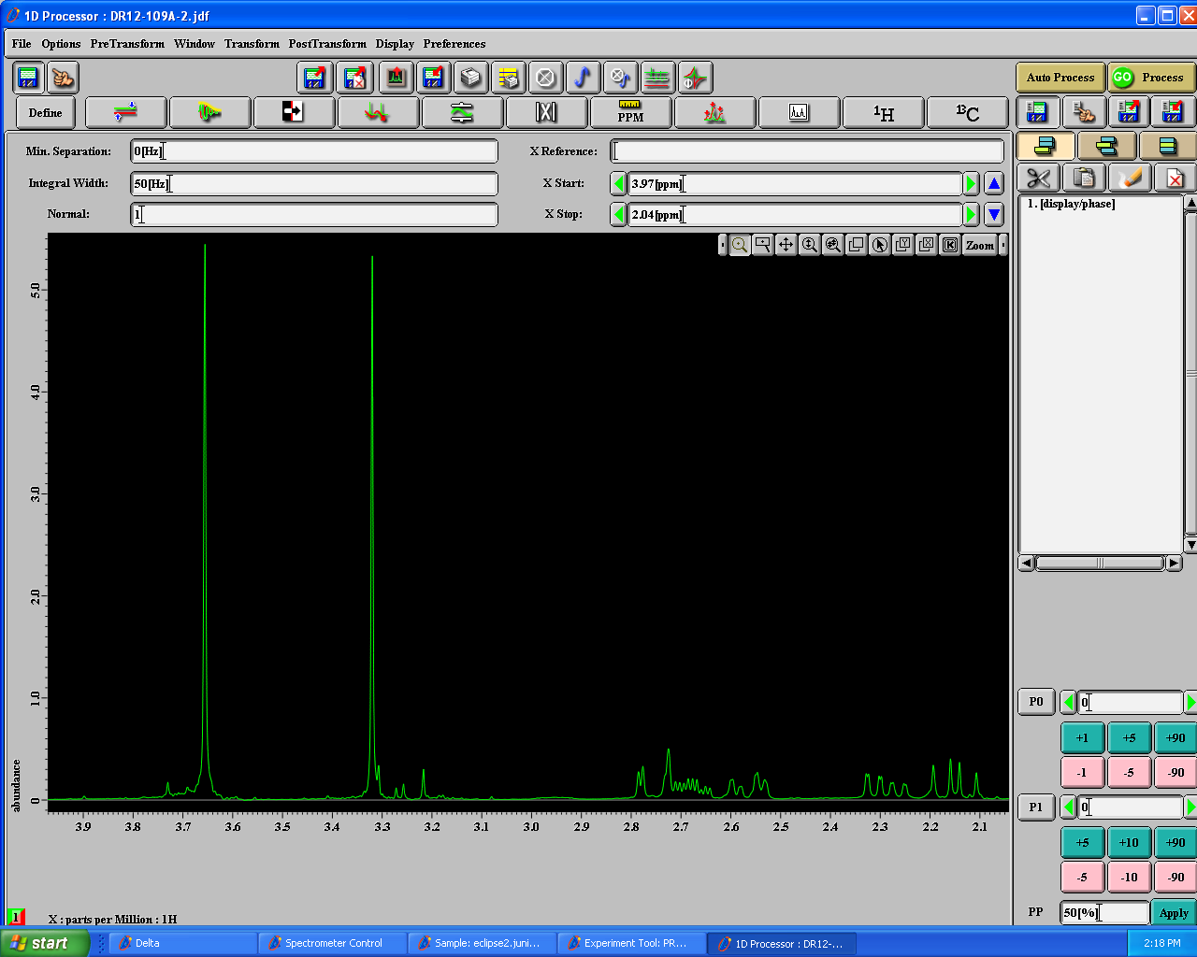
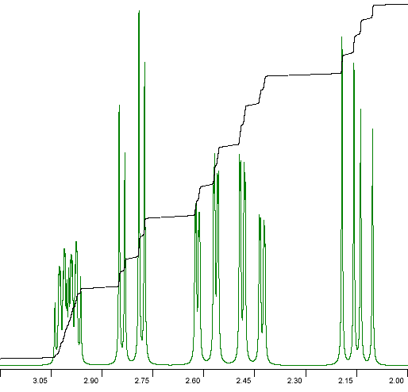
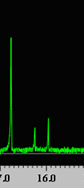
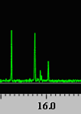
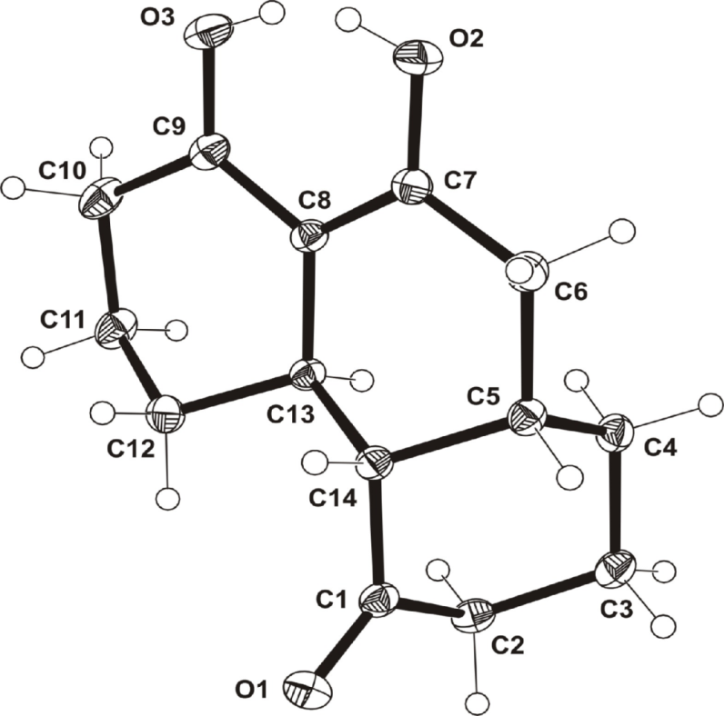
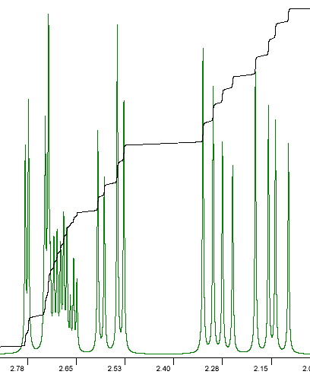
Approaches to Hydroxylated Polyacenes I. David Reingold, Zachariah A. Page, and Anh Nguyen Department of Chemistry, Juniata College, Huntingdon, Pa 16652
Supported By
NSF REU
Chemistry
Ultimate Research Goals
Base
Michael-Claisen
Dehydrogenation
Base
Synthesizing Building Blocks
IBD
75 % Yield
Potential uses in OLED’s, photovoltaic cells, non-linear optics, and field effect transistors
MeOH
Model Condensation Reaction
1 eq
excess
Goals:
Reduce Reaction Time
Reduce Temperature
Minimal Solvent
Increase Yield
Potential Problems:
Polymerization
Decomposition
This is a model of the reaction scheme to make polyhydroxy-kekulene. This is one “corner” of the molecule.
Base | Solvent | Temperature (⁰C) | Time (hr) | Yield (%)
DBU | NMP | 130 | 19.5 | 14
 | DBU (1 Eq H₂O) | 100 | 23.5 | 30
 | Acetonitrile | 100 | 3 | none
KOH | NMP | Microwave: 300 W, 10 % | 5-15 min intervals for 3 hr | none (trouble decarbox.)
 | NMP | 110 | 6 days | 5
TEA | TEA | 120 | 8 days | 16
 | TEA | 130 | 5 days | 14
Base | Solvent | Temperature (ºC) | Time (hr) | Yield (%)
DBU | NMP | 120 | 27.5 | 14
 | DBU (1 Eq H₂O) | 95 | 24 | none
KOH | NMP | 95-120 | 7-27.5 | none
Cs₂CO₃ | NMP | 120 | 30 | none
KOC(CH₃)₃ | Acetonitrile | 80 | 22 | none
Four possible stereoisomers—ratio varies with conditions
Diagnostic proton ~16 ppm
Simulation
Isomer obtained in NaH/THF
Isomers obtained in NaH/DBU
X-ray shows that isomer from THF is this one
Reingold, Butterfield, Daglen, Walters, Allen, Scheuring, Kratz, Gembicky, Baran, Tetrahedron Letters 2005, 46, 3835-3837.
Isomers obtained in NaH/Pyridine
Simulation
Future Research
Isolate and identify the other three isomers.
We believe that the methoxide leaving group may be reacting with our starting material, catalyzing the Baylis-Hillman reaction, and thus reducing our yield. So we would like to synthesize a reactant with a tert-butoxide leaving group, in order to prevent the nucleophilic reaction from happening.
Future Research
Isolate one-arm diester, then decarboxylate separately
Drip Ketal into base/DMM/ solvent mixture slowly to decrease polymerization.
Make tert-butyl esters

