Slide 1
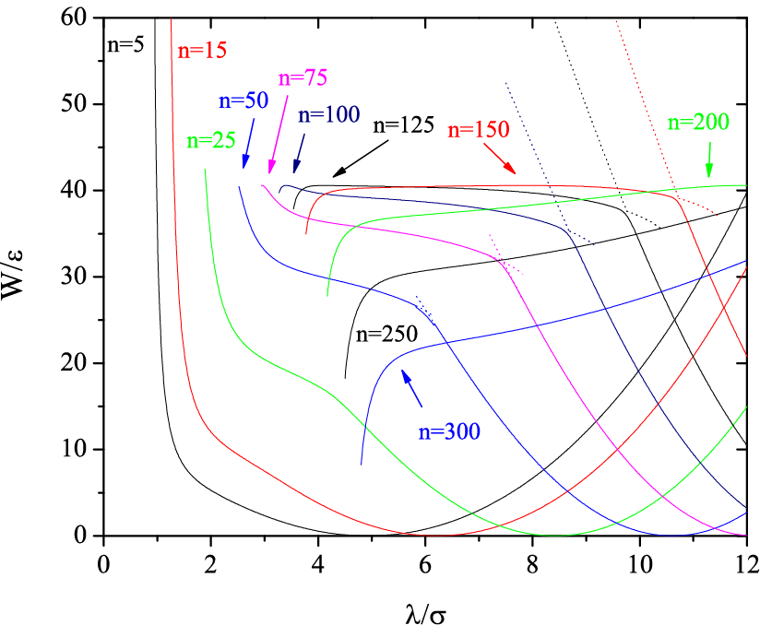
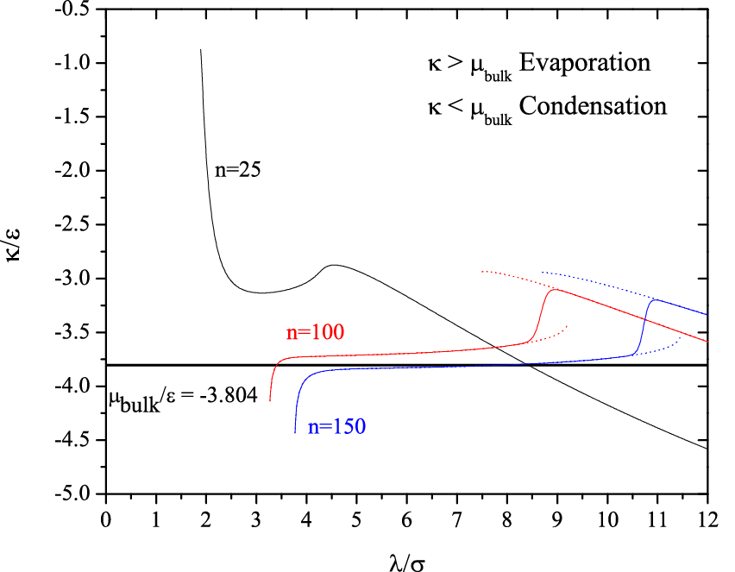
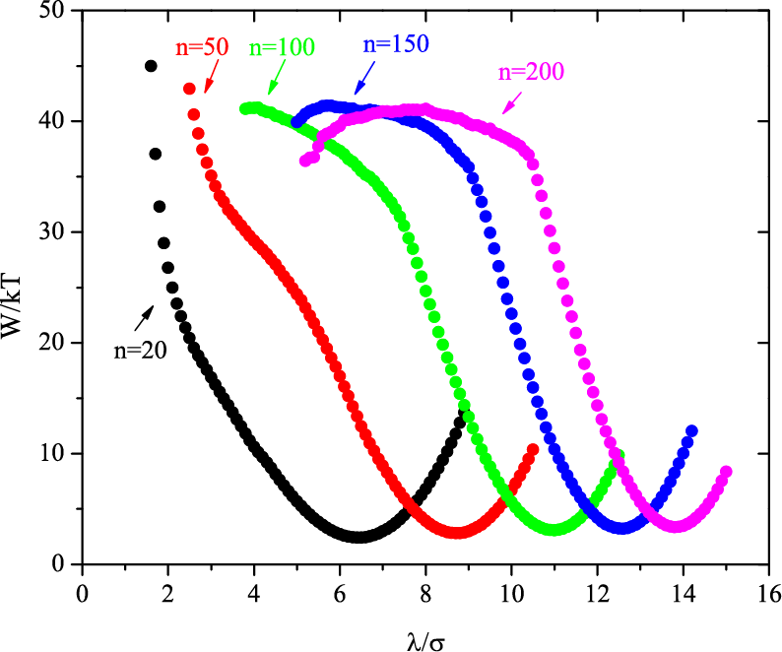
Activated Instability of Homogeneous Droplet Nucleation and Growth
David S. Corti, School of Chemical Engineering, Purdue University, West Lafayette , IN 47906
The reversible work, W, of forming a droplet of given n and radius λ within the
supercooled Lennard-Jones (LJ) vapor at kT/ε=0.8 and and ρσ³=0.01 obtained
from constrained density-functional theory (DFT). For n>15, each profile terminates
at a limit of stability. A flat ridge develops, i.e., maxima in W have the same values, for
larger droplet sizes. Hence, homogeneous droplet nucleation is more appropriately
described as an “activated instability”: once the droplets surmount the free energy
barrier the free energy surface serves to channel the embryos towards the stability
limits; the growth phase proceeds via a mechanism appropriate for an unstable fluid.
This is a new and intriguing picture of the molecular mechanism of droplet formation.
The chemical potential, κ, of
the droplet versus its radius.
The droplet and vapor are in
chemical equilibrium when
κ = μ_{bulk} , which occurs along
the ridge. The growth phase
corresponds to κ < μ_{bulk} . This
plot shows that the DFT
predictions yield results that
are physically consistent with
the process of nucleation.
The reversible work, W, of forming a droplet within the supercooled LJ vapor
at kT/ε=0.8 and Pσ³/ɛ=0.01247 obtained from isothermal-isobaric Monte
Carlo simulations. The key features of the DFT predictions, such as the flat ridge
and limits of stability, are verified by the simulation.

