Slide 1
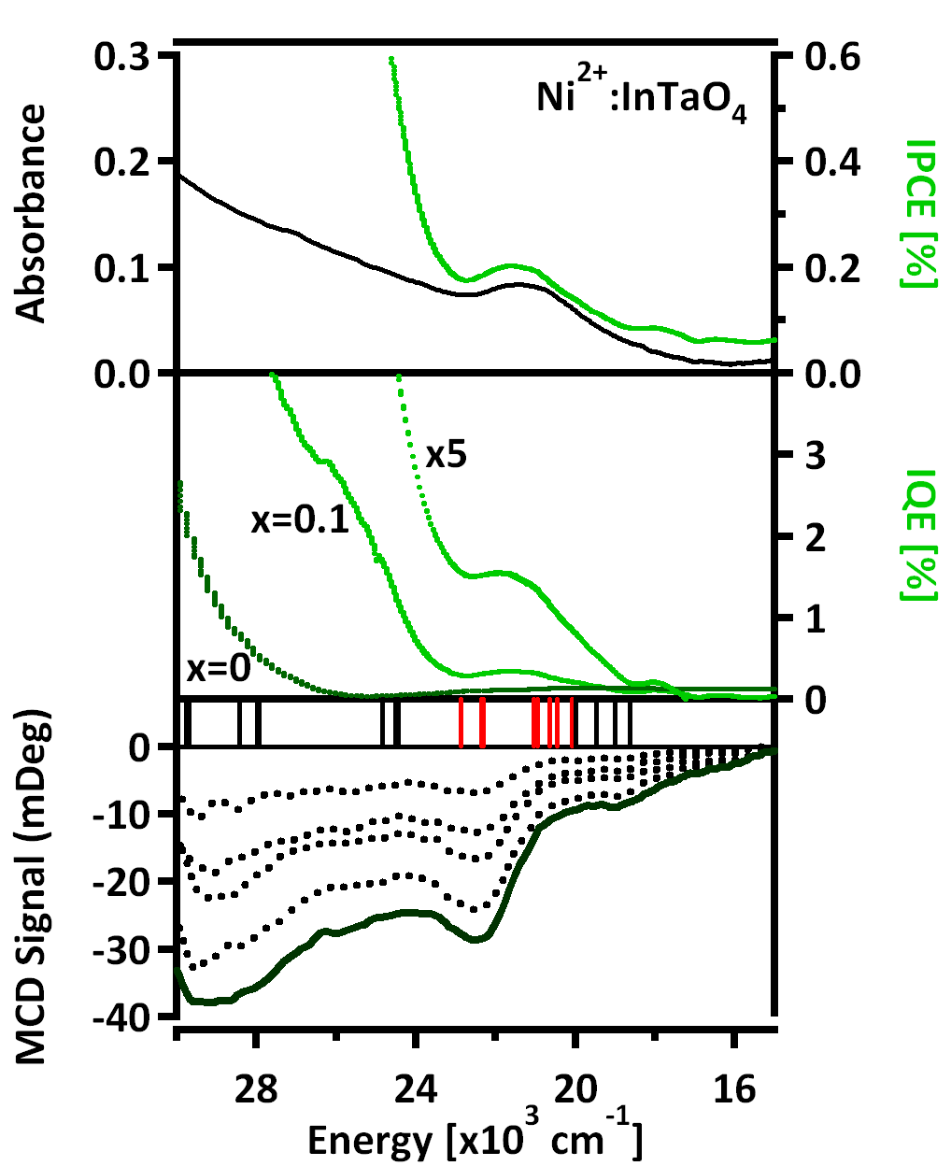
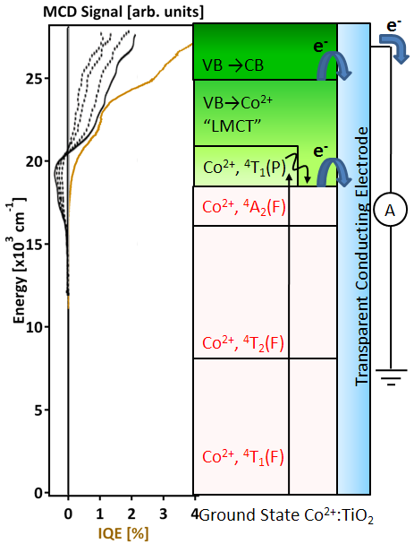
Spectroscopy of Photovoltaic and Photoconductive Doped-Oxide Electrodes Related to Photocatalysis and Solar Energy Conversion
Diane K. Zhong, Daniel R. Gamelin. Department of Chemistry, University of Washington , Seattle, WA 98195
Water splitting with inorganic oxide semiconductors:
TM^{n+} doped metal oxide materials have been shown to catalyze water splitting under visible light irradiation. H₂/O₂ production often follow sub-bandgap electronic absorption directly associated with the dopants themselves , but no definitive reasoning can be drawn.
BG
MLCT
³A₂ → ³T₁(P)
Spectroscopy of Photovoltaics:
We aim to understand the general mechanism of sensitized photoinduced charge separation by a series of absorption, photocurrent
action, and magnetic circular dichroism (MCD) spectroscopies on various doped oxide semiconductors.
We successfully identified the electronic transitions responsible for sub-bandgap photocurrent in Co²⁺:ZnO, Ni²⁺:ZnO, Cr³⁺:TiO₂, Co²⁺:TiO₂, and Ni²⁺:InTaO₄. We demonstrated that these transitions can give rise to photocurrent by charge transfer and excitonic state mixing. Ligand field transitions are not directly photoactive, but may enhance photoelectrochemical responses by sensitization of charge transfer transitions. Future studies will focus on developing new photoactive oxide materials for water splitting. Emphasis will be placed on application of various spectroscopic techniques to advance our understanding of dopant-induced solar photochemistry.

