Slide 1
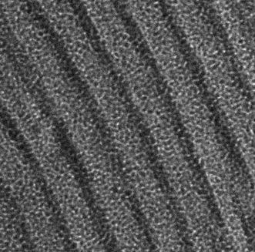
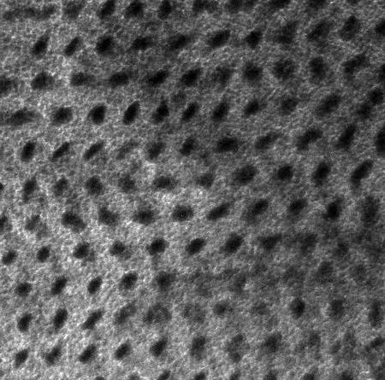
Templating Ion-Conducting Membranes Using Block Copolymers
We have investigated the self-assembly of cylinder-forming PS-b-PEO (SEO) block copolymers doped with various lithium salts. SAXS and TEM confirm that salt doping increases the domain spacing and segregation strength. Additionally, the lithium counterion is shown to affect the morphologies and induces unique thermal phase transitions.
SEO:LiClO₄ 3:1
q/q* =
1
SAXS
2
3
4
[EO]:[Li]
1
TEM
Log Intensity (a.u.)
1
√4
√7
√9
Scale bar : 20 nm
RuO₄ staining
1
√4
√7
SEO neat
1
√3
√7
√9
√3
1
q (Å⁻¹)

