Slide 1
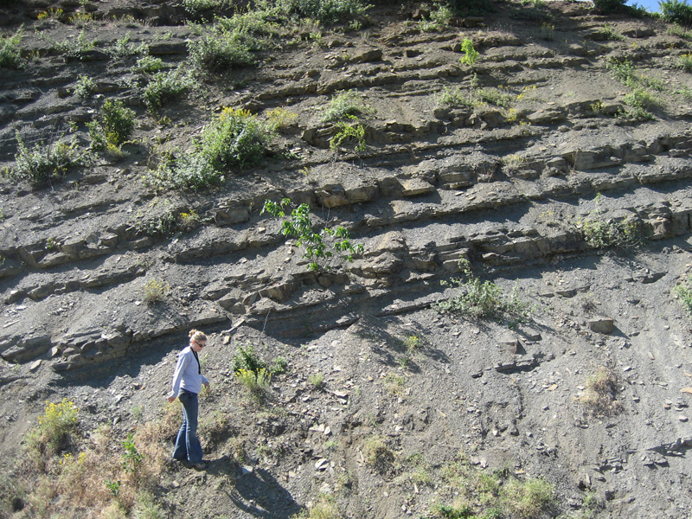
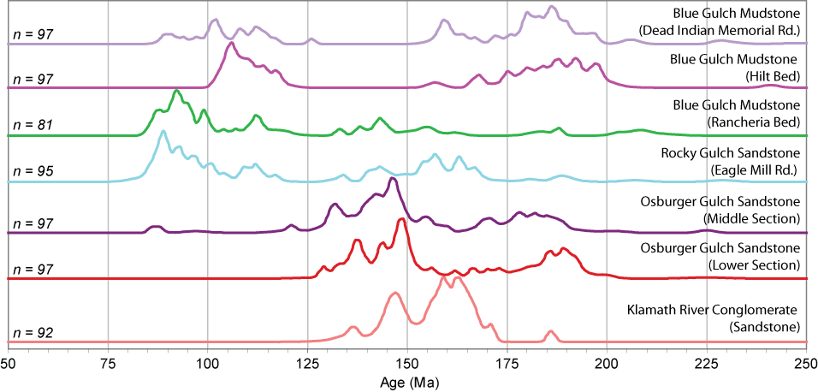
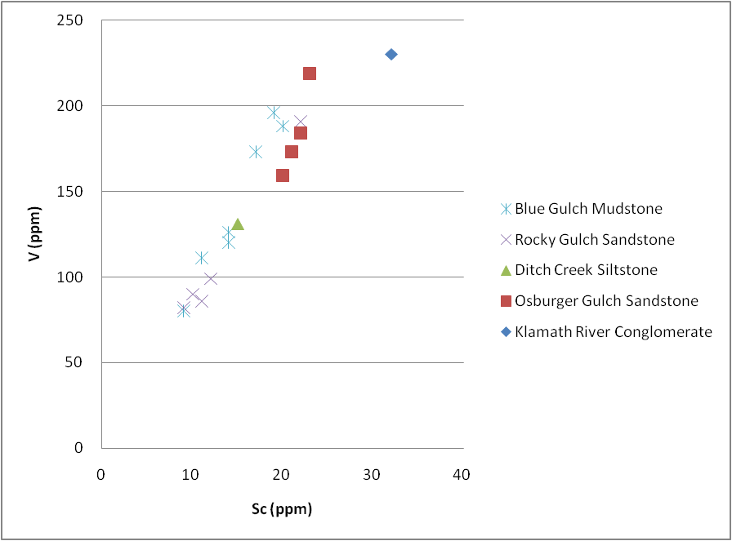
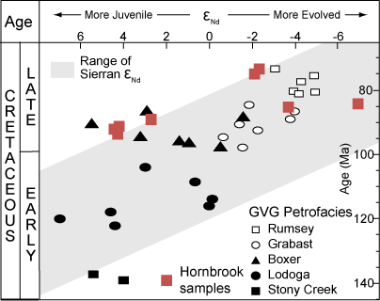
Detailed provenance analysis of the Hornbrook Formation, Oregon and California
Kathleen D. Surpless, Department of Geosciences, Trinity University, San Antonio TX 78212
Significant results:
Appearance of Late Cretaceous age peak in upper Hornbrook members requires non-Klamath sediment source
Apparent trend toward decreasing volcanic input and more evolved sources through all but the uppermost Hornbrook member suggests Sierran arc source
Continuing work:
Verify and document apparent trends in geochronology and geochemistry to test spatial versus temporal relationship throughout the Hornbrook basin
Document changing sediment sources through time to guide Cretaceous paleogeographic reconstruction of CA-OR region

