Slide 1

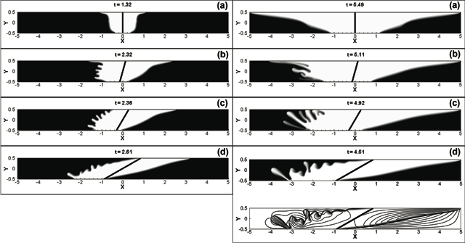
Miscible Porous Media Displacements
Eckart Meiburg
UCSB
Displacement fronts for miscible displacements of a more viscous, denser fluid by a less viscous, lighter one at source inclination angles of α = 0º, 15º, 30º and 60º, respectively. For the right-propagating fronts at nonzero angles, the tendency of the focusing mechanism to form a dominant viscous finger along the top boundary of the reservoir is reinforced by an emerging gravity tongue, resulting in early breakthrough. The left-propagating fronts, on the other hand, are characterized by vigorous viscous and/or gravitational fingering, which leads to the disintegration of the dominant finger along the bottom.

