Slide 1
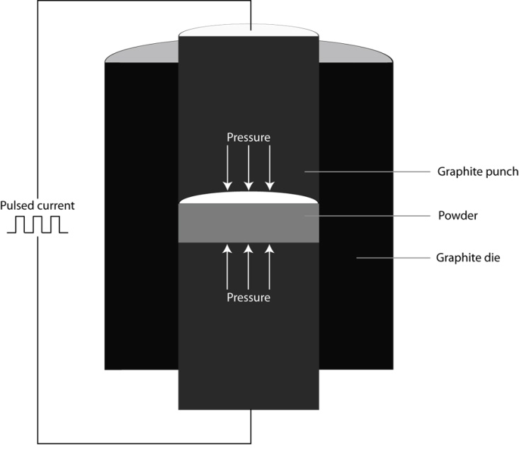
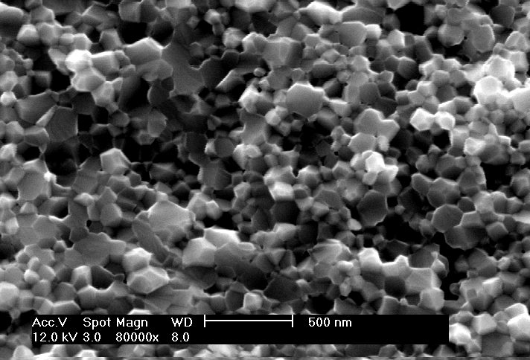
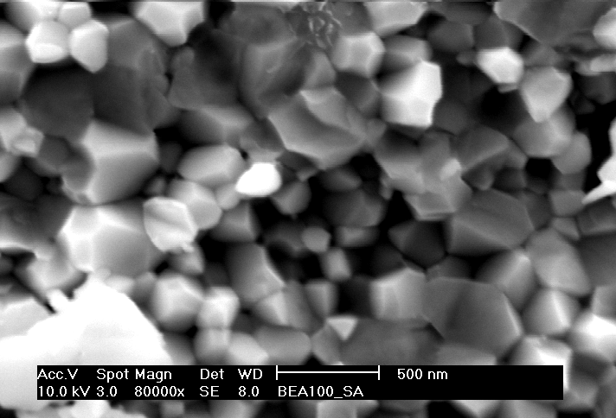
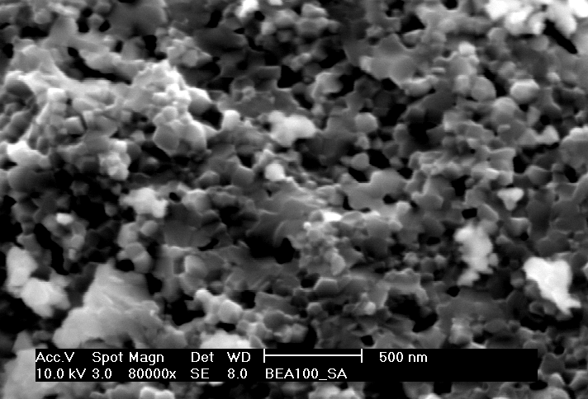
Spark Plasma Sintering of Ceria Materials for Solid Oxide Fuel Cells Applications
Lia Stanciu, School of Materials Engineering, Purdue University, West Lafayette, IN 47907
Sm, Gd and Yb doped ceria powders were synthesized by a solution method
Fully dense samples were obtained by SPS sintering at 1100ºC for Sm, Gd and Yb doped ceria.
(a)
(b)
(c)
Despite the fact that Yb-doped sample had the largest initial particle size, the grain growth upon SPS sintering was promoted at a higher extent in the Sm doped sample, displaying the highest ionic conductivity. Yb doping produced the finest grain size in the SPS sintered samples, while displaying the lowest total ionic conductivity.

