Slide 1
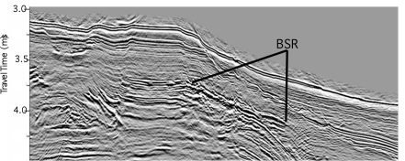
Multi-channel Seismic Analysis of Gas Hydrates and Related Geological Structures in the Northwestern Gulf of Mexico
William W. Sager, Department of Oceanography, Texas A&M University
The northwest Gulf of Mexico continental margins show a morphologic transition from rough to smooth moving from Louisiana across Texas to Mexico. Likewise, Bottom Simulating Reflectors (BSR), an indicator of natural gas trapped beneath gas hydrate deposits in the margin sediments, are seen on the Mexican continental margin but appear rare in the northern Gulf of Mexico. We are studying industry multichannel seismic profiles in an effort to refine our knowledge of the structural transition, its related faults and buried salt structures, and their relationships to the occurrence of BSR and gas hydrate in the northern Gulf of Mexico. The project is supporting graduate students to interpret the seismic profiles as a part of their graduate training.
Seismic profile over Sigsbee Escarpment (below); Example of BSR from Gulf of Mexico (right)

