Slide 1
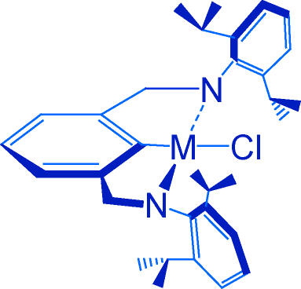
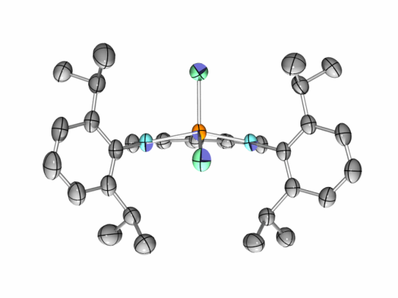
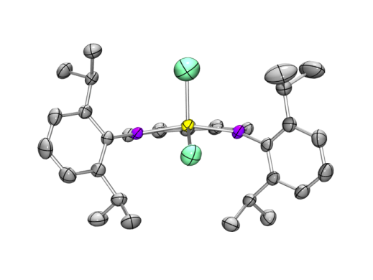
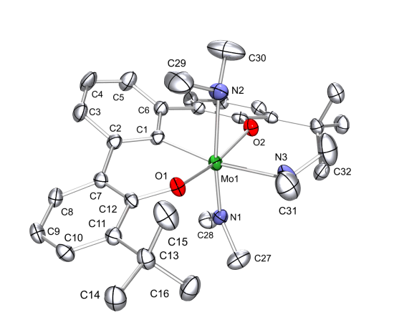

Bridging the Gap Between Early and Late-Metal Catalysis: d² Square-Planar Complexes That Mimic Their d⁸ Counterparts
Adam S. Veige, Department of Chemistry, University of Florida, P.O. Box 117200, Gainesville, FL, 32611
Aryl groups protect above
and below square plane
Pincer ligand enforces
a planar geometry and
places a metal-carbon
Bond trans to the
functionalized site
Halide site for
functionalization
Can fine tune pincer backbone and aryl groups
[NCN]TiCl²⁻
[NCN]ZrCl²⁻
Target Complex
Isolated Group IV Pincerate Complexes
DFT calculations predict sq-planar geometry for
M = Mo, with filled dz² HOMO
Alternative OCO³⁻ trianionic
pincer ligand

