Slide 1
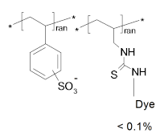
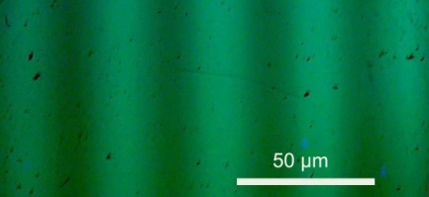
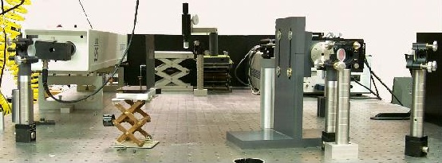
The purpose of the research is to assess the nature and duration of interactions that draw two strongly and negatively charged polymer chains (red) towards each other under conditions of low salt. The work has ramifications for self-assembly, packing of nuclear DNA and origin of life.
The research combines synthesis of fluorescently labeled model polymer from monomer (above right), construction of a new
apparatus (below) to measure diffusion by exponential decay of the contrast after nondestructive photobleaching (stripes at right).
Na⁺
Na⁺
Na⁺
Na⁺
-
-
-
Na⁺
Na⁺
Na⁺
Na⁺
-
Na⁺
Na⁺
-
Na⁺
-
Na⁺
-
Na⁺
Na⁺
Na⁺
Na⁺
Na⁺
-
-
-
Na⁺
Na⁺
-
Na⁺
-
Na⁺
-
-
Na⁺
Na⁺
Na⁺
-
Na⁺
-
-
-
Na⁺
Na⁺
-
Na⁺
Na⁺
Na⁺
-
-
-
-
Na⁺
Na⁺
-
-
-
Na⁺
Optical Tracer Self Diffusion Studies of Polyelectrolytes at Low Salt
Paul S. Russo Louisiana State University ACS PRF# 45430-AC7

